Slide 1
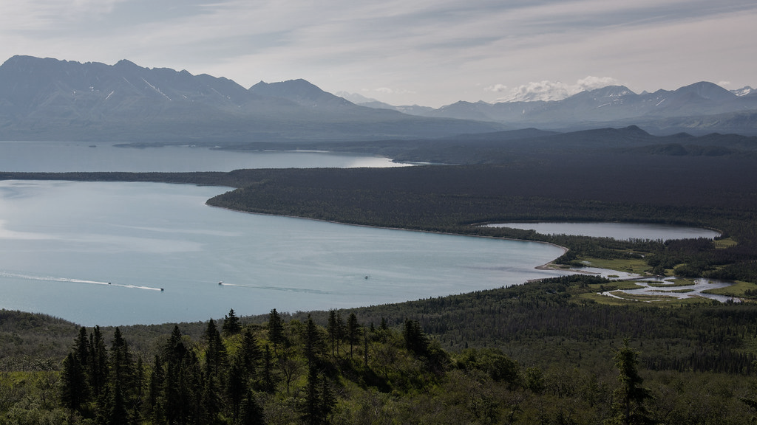
CLEAN ENERGY DEVELOPMENT IN BRISTOL BAY & BEYOND UTBB Sustainability Summit Dillingham, AK March 23, 2023 Brian Hirsch, PhD CEO, DeerStone Consulting

Slide 2
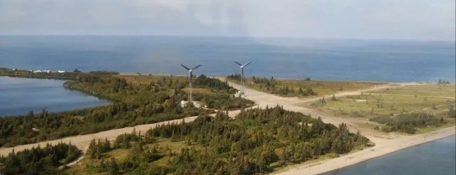
Tribal Energy Development Capacity (TEDC) Grant Awards from BIA Phase 1 – 2020; Phase 2 - 2023 Utility Collaborative
2020 TEDC Award - $125k
Vetting the Concept of Collaboration
Economies of Scale
Reduced Utility Costs
Improved Reliability
Utility Preference + Interest
Establish Steering Committee
2022 TEDC Award - $300k
Prove the benefits of a collaborative
~ 5 Participating Utilities
Accounting Support
Diesel Generator & Powerline O&M
Prepare for/Support Renewables

Slide 6
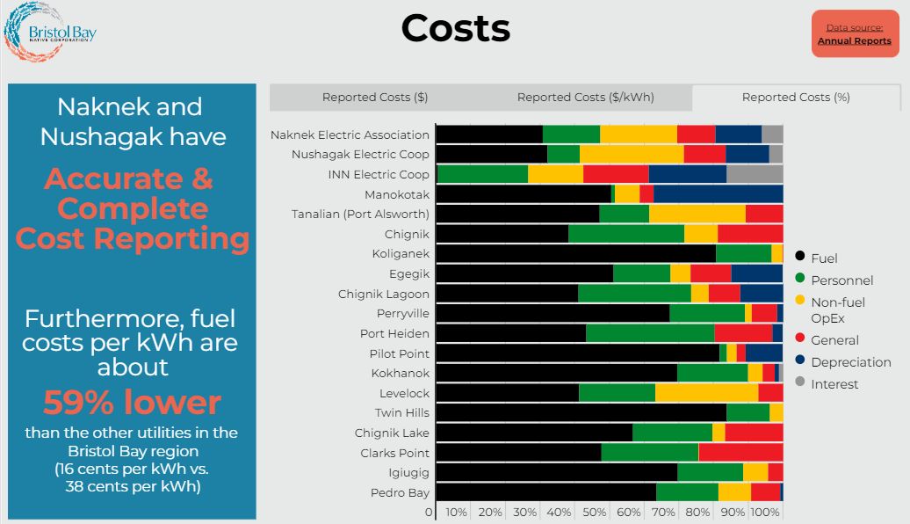

Slide 8
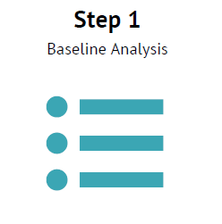
Step 1 – (Recap) Baseline Analysis Indications
Several small utilities could use immediate support (finance & accounting, PCE Reporting, operations, maintenance)
Trained personnel in the larger utilities could be used to alleviate O&M and training needs in smaller utilities
Most utilities would benefit from planned infrastructure improvements
High reliance on diesel across the board could be alleviated by integration of renewables (volatility in prices being realized now)
Economies of scale if banded together: fuel purchase, installing new equipment/infrastructure, generator overhauls

Slide 9
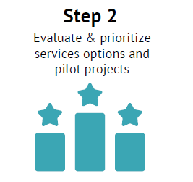
Step 2 – (Recap) Prioritize Services
PCE Reporting and Bookkeeping Training/Support*
Infrastructure Engineering Assessment – to plan for infrastructure improvements**
Powerplant Operator – Operations & Preventative Maintenance Training Support***
Bulk Fuel Purchasing
*To include rate setting, billing/collections support, replacement and reserve account targets and savings plan.
**Incremental improvement working towards potential renewable integration. Will include upgrades to target line losses and generator efficiencies to improve PCE benefit.
***Trained personnel in the larger utilities could be used to alleviate O&M and training needs in smaller utilities. Focus on generator maintenance.

Slide 10
Shared Services Approach to Managing Rural Power Utilities
Utilities share certain services to maximize performance, save money, and improve reliability of power. This can remove burden from independent utilities while reducing costs.
The utility ownership DOES NOT change.
The “Collaborative” is the shared pool of resources that utilities will tap into. It’s basically outsourcing defined roles and responsibilities to the shared pool of resources.
“Members” are the utilities that decide to participate and outsource some of their roles and responsibilities to the Collaborative.

Slide 11
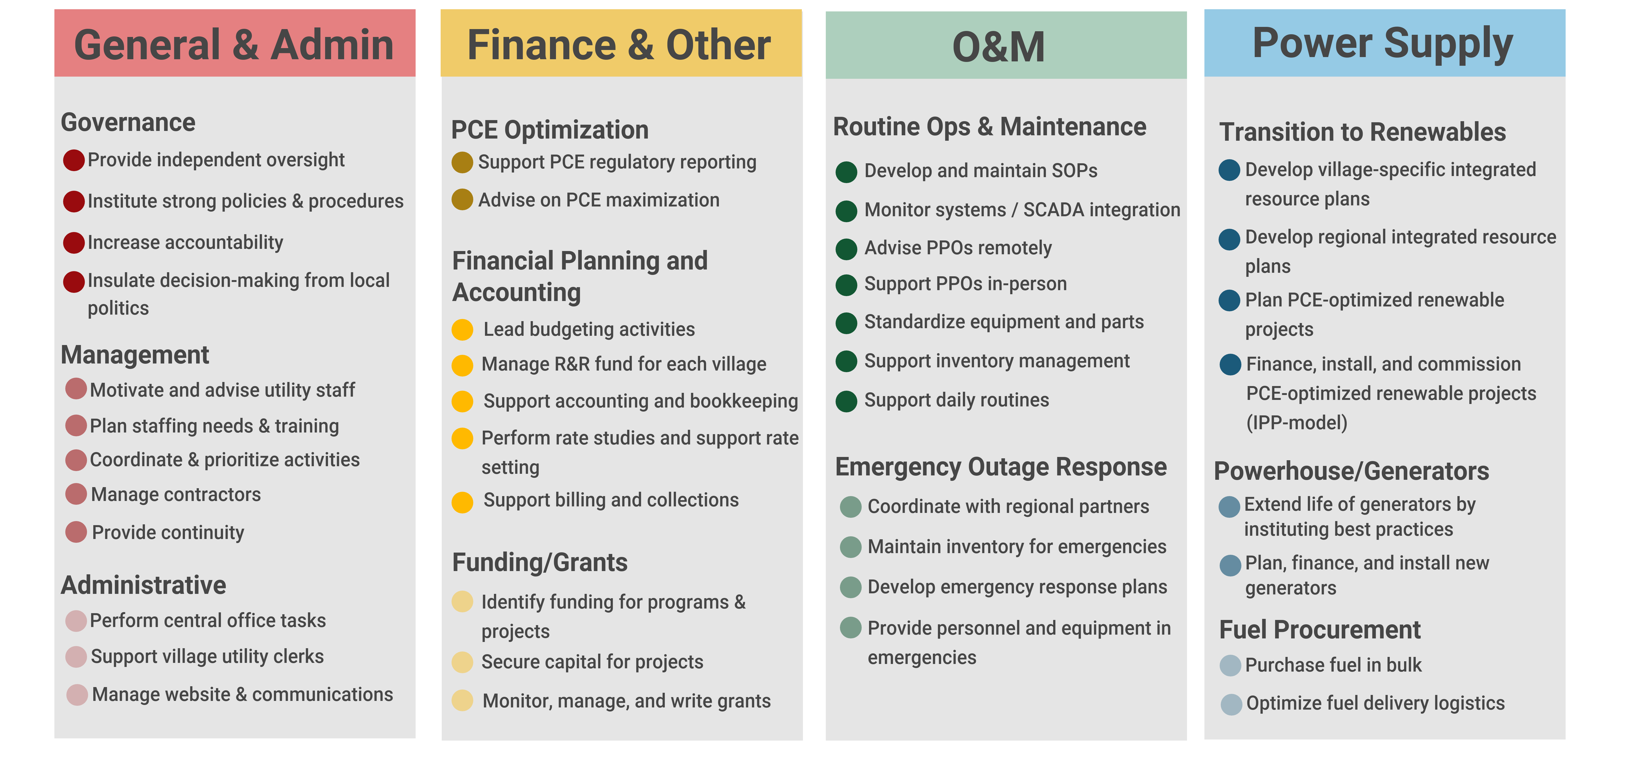
Activities the Organization Could Perform
Main theme: share resources, personnel, training, inventory, best practices, etc.

Slide 12
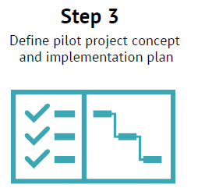
Step 3 – (Recap) Define Pilot and Plan
BIA Funding Round 2 ($300k)
MOAs – BBNC/Participant Utilities
Project Manager, Electric/Mechanical Contractor, PCE/Accounting Contractor – Hire or Contract Out
Accounting & PCE T.A. – Maximize PCE, Rate Setting, Reserves Goal
O&M: Preventative Maintenance T.A. – Training PPOs, Develop & Implement PMPs

Slide 13
Other Regional Initiatives Across Alaska
NANA/Northwest Arctic Borough
Independent Power Producers selling renewable energy, regional technical support, revenue contribution to organization
Tanana Chiefs Conference
Renewable Energy and Broadband infrastructure development
Nuvista Light & Electric Cooperative
IPP formation, technical support, cross-community training
Southeast Conference, SEAlaska/Spruce Root, IPEC
“Energyshed” project with Launch Alaska
Bundle multiple projects for cost savings, possible investment opportunities

Slide 14
Funding Opportunities
US Department of Energy
Grid Resilience (Formula grant for Tribes, due May 31)
EECDBG (non-competitive, first step due April 28)
Office of Indian Energy – Tribal Deployment Grants, due May 16
Energy Improvements in Rural or Remote Areas, Concept paper due April 14
Energizing Rural Communities Prize, phase 1 due May 24
US Treasury
Tax Credits & Direct Pay for non-profits (Inflation Reduction Act)
Denali Commission - due April 14
USDA Community Connect Broadband, due June 20
NTIA Tribal Broadband – Expected Announcement Soon

Slide 15
Potential Projects in Region & Federal Funding Opportunities
Roads
Power Plant Upgrades
Renewable Energy
Docks
Mapping
Community Facilities
Broadband
Notes:
Iliamna Dock
Chignik Bay Hydroelectric Dam
Kaskanak Road
Nondalton Road – Newhalen River Bridge
Diamond Point Port, Road, Quarry
Multipurpose Buildings – Kokhanok, Igiugig
Fish Processing – Levelock, Port Heiden
Renewable Develoipment
Pilot Point – Road to Bulkhad
Renewable Energy + Batteries – Port Heiden, Pilot Point, Ugashik, Igiugig, Levelock, others

Slide 16
The Road Ahead…
Substantial federal funding available
Tremendous regional need
Regional stakeholder coordination
Project readiness

Slide 17
Quyana! Chin’an!
Brian Hirsch, PhD
DeerStone Consulting
brian@deerstoneconsulting.com
907-299-0268
Questions?
Notes:
Key Competencies + Experience
Renewable Energy
Utility Management
Grant Writing
Grants Management
Business Planning
Environmental Review
Project Management
Facility Construction, Water + Sewer, Transportation, Broadband
Regional Clients
Lake and Peninsula Borough
Igiugig
Port Heiden
Kokhanok
Ugashik

