Slide 1
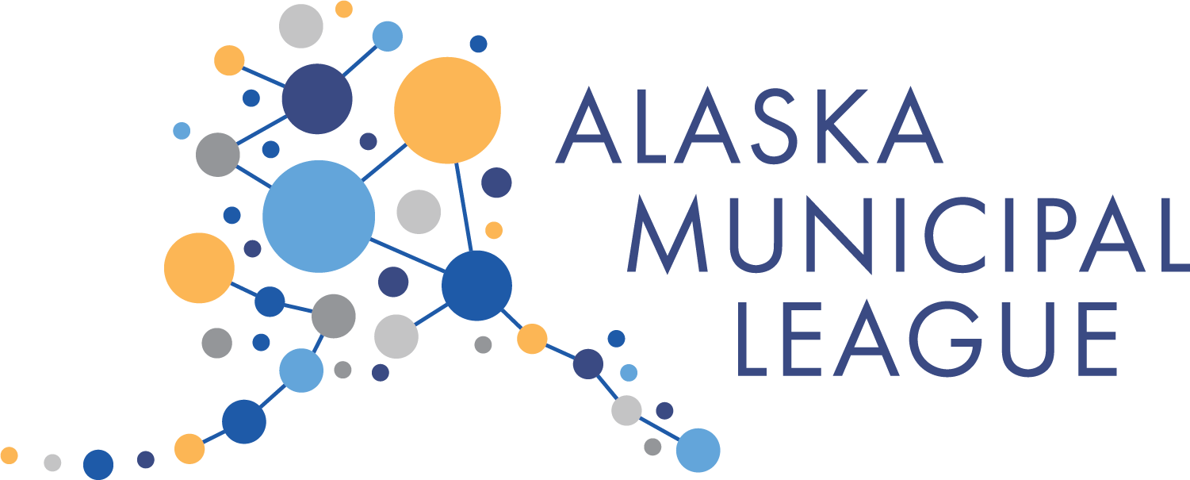
Federal Funding Opportunities
Bristol Bay Sustainability Summit
March 23, 2023
Erin Reinders
Director of Infrastructure Development
erin@akml.org
Notes:
Thank you so much for having me today! Good Morning, Friends!
I am Erin Reinders, the Infrastructure Program Director with the Alaska Municipal League.
AML is a nonprofit, nonpartisan, statewide organization with a purpose of strengthening Alaska’s local governments. We are committed to supporting Alaska’s 165 cities and boroughs, in maximizing the benefit to Alaska, and fostering statewide collaboration, especially with all the opportunities coming from the Bipartisan Infrastructure Law.
This morning I will share a bit about what opportunities are out there
So lets get started!

Slide 2
BIL/IIJA Overview
Signed into law by President Biden one year ago, on November 15, 2021
Authorized $1.2 trillion for transportation and infrastructure spending
$550 billion of that figure going toward “new” investments and programs
Urgency can be spread across at least the next five years; implementation over the next ten
Goal for Alaska is $3 billion/year; including $1 billion in successfully competed grants ($3.7 Million as of March 2023!)
Notes:
The Infrastructure Investment and Jobs Act (IIJA), aka Bipartisan Infrastructure Law (BIL), was signed into law by President Biden on November 15, 2021. The law authorized $1.2 trillion for transportation and infrastructure spending with $550 billion of that figure going toward “new” investments and programs. Combination of formal funds and competitively awarded grants.
IIJA is projected to bring about $18 billion to Alaska, or nearly $25,000 per Alaskan.
This is considered to be a once in a generation investment.

Slide 3
BIL/IIJA Infrastructure “Buckets”
Energy & Power –
Upgrade Electricity and Transmission Infrastructure
Water & Sewer – Ensure Clean Drinking Water and Sanitation
Internet & Cybersecurity – Provide High Speed Internet for All
Transportation - Improve Transportation Systems
Promote Resiliency
Notes:
IIJA funding falls into five broad categories – or “buckets” –
internet and cybersecurity;
energy and power,
transportation systems including docks, airports, bridges and more;
water and sewer,
and resilience.
Resiliency incudes wildfire management,
All of which can have a huge impact on Alaskan communities.

Slide 4
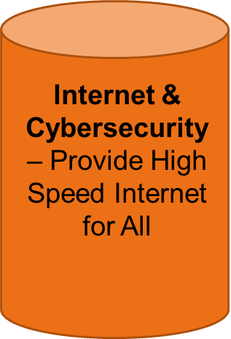
BEAD & DEA
State of Alaska partnering with the Rasmuson Foundation to develop Digital Equity Plan.
This will fold into the State’s 5-Year rollout plan for Broadband Equity, Access, and Deployment Program (BEAD)
Alaska Broadband Office: https://www.commerce.alaska.gov/web/abo/
Digital Equity:
https://broadbandforalaskans.org/
Notes:
BIL or IIJA provides$2.75 billion to expand broadband access and promote digital equity and inclusion
Not so much a grant program just yes for communities, but I wanted to give a little bit of update on what’s happening here…
To access the state’s share of this funding, the State is required to put together a 5-year plan for broadband equity, access and deployment (BEAD). They are also required to develop a Digital Equity Plan that will help to inform this over all 5-year plan.
National Telecommunications and Information Administration (NTIA) -
The condition in which individuals and communities have the information technology capacity that is needed for full participation in the society and economy of the United States.
Includes…
Availability (service is available & reliable)
Affordable (service is affordable)
Accessible (service is useable – technical tools & understanding)
The States Digital Equity Award Planning Grant -just under $568 thousand dollars - is being used to create a comprehensive Digital Equity Plan .
The State of Alaska is partnering with the Rasmussen Foundation to develop the Plan.
AML, among several other organizations, are all assisting the Rasmussen foundation in leading Digital Equity Listening Sessions and Engagement Tour in hopes of truly meaningful engagement that will help inform states efforts and to break down the digital divide.

Slide 5
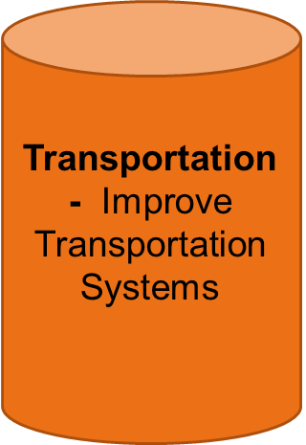
Port Infrastructure Development Program (PIDP)
Eligible: Port authority, state, local government, and tribes
Open now! Closes on April 28, 2023
Annual appropriation for the next five years was nearly doubled by BIL to $450 M
An additional $212M was made available to the program under the FY2023 Consolidated Appropriations Act, resulting in a total of $662M in FY 2023 PIDP grant funding
While normally a 20% match, less than a 20% match can be requested if project is:
a “small project at a small port” - defined as <8m annual tons with <$11.25 million requested
located in a rural areas
Inland river ports are eligible

Slide 6
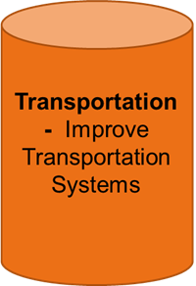
Safe Streets and Roads for All (SS4A)
Eligible: Local governments, tribes, MPOs, and other regional groups
Opening in April 2023
$5-6 Billion Over 5 years
The following activities are eligible for the SS4A program:
Develop or update a comprehensive safety action plan (Action Plan).
Conduct planning, design, and development activities in support of an Action Plan.
Carry out projects and strategies identified in an Action Plan.

Slide 7
Multimodal Transportation Project Grants (MTPG)
Eligible: State, MPOs, local governments, transportation districts/authorities, tribes, and consortiums of tribes
Opening Spring of 2023
$1.55 Billion Annually
Three programs:
INFRA
Mega
Rural
Different programs vary in match, criteria, award amount.
Much of Alaska is eligible under Rural (Rural Surface Transportation Grant).
Highways, bridges, tunnels, eligible – planning and implementation.

Slide 8
Bridge Investment Program (BIP)
Eligible: State, MPOs, transportation districts, local governments, tribes, federal land agencies
Opening Summer of 2023
$2.36 Billion Annually
Goal is to reduce number of bridge in poor condition, or at risk of falling into poor condition
Required to be on the National Bridge Inventory
Program includes:
(1) Planning
(2) Bridge Projects (projects with eligible costs less than $100 million)
(3) Large Bridge Projects (projects with eligible costs greater than $100 million)

Slide 9
Rebuilding American Infrastructure with Sustainability and Equity (RAISE)
Eligible: States, Local governments, transportation districts/authorities, and tribes
Just closed on Feb 2023, so be on the look out for next year!
$7.5 billion over 5 years
Formerly BUILD & TIGER, this program funds road, rail, transit and port projects that have a significant local or regional impact.
Both planning and implementation are eligible.
No match for Rural Communities (This year, that was all but Anchorage in Alaska)

Slide 10
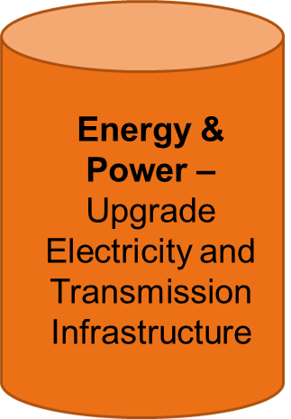
Energy Improvement in Rural or Remote Areas (ERA) Program
Eligible: States, Local governments, Utilities, Tribes, and more
For Communities with 10,000 or fewer people
Open now!
April 14, 2023, Concept Paper
June 28, 2023, Application Deadline
$300 million this round
Anticipating 4-20 awards between $1-100M each with a minimum of 20% or 50% applicant cost share
Goal to advance clean energy demonstrations and energy solutions that are replicable and scalable for rural and remote areas of the U.S.
Projects might include:
Overall cost-effectiveness of energy generation, transmission, or distribution systems;
Siting or upgrading transmission and distribution lines;
Reducing greenhouse gas emissions from energy generation by rural or remote areas;
Providing or modernizing electric generation facilities;
Developing microgrids; and
Increasing energy efficiency.

Slide 11
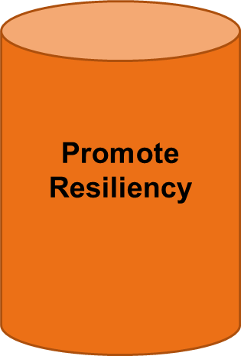
Building Resilient Infrastructure and Communities Program (BRIC)
Eligible: State Agencies, Boroughs, Cities, and Federally Recognized Tribal Governments with a FEMA Approved and Locally Adopted Hazard Mitigation Plan
A community or tribe will be referred to as a Sub applicant once an Intent to apply (ITA) to the State, the State will be referred to as the Applicant.
NOFO anticipated in August 2023 with applications due late December 2023
Interested? Rai Simpliciano, State of Alaska BRIC Program Manager: mvamitigation@alaska.gov
Eligible Types of work include…
Risk Analysis
Hazard Mitigation Planning
Projects that help design, scope, identify or reduce risks from natural hazards
Protection of Critical Infrastructure from Natural Hazards
Emergency Back Up Power for Critical Facilities
High Wind Retrofit / Protection
Critical Utility Hardening / Protection
Wildfire / Combustible Fuels Reduction Projects

Slide 12
Public Works and Economic Adjustment Assistance (PWEAA)
NOFO issued on March 15, 2023
There are no application submission deadlines. Applications will be accepted on an ongoing basis until the publication of a new PWEAA Notice of Funding Opportunity (NOFO), cancellation of this PWEAA NOFO, or all available funds have been expended.
EDA is expected to provide up to 3,000 awards, and counties can directly apply for grants up to $30 million.
Each project must be consistent with the region’s current Comprehensive Economic Development Strategy (CEDS)
Examples of projects that have been funded previously include, but are not limited to:
Acquisition and development of land and improvements for use in public works or other types of development facilities
Design and engineering, construction, rehabilitation, alteration, expansion, or improvement of public works, public service, or related development facilities, including related machinery and equipment;
Water and sewer system improvements, expansion of port and harbor facilities
Construction or expansion of facilities for workforce development
Redevelopment of brownfield sites
Expansion, construction, or improvements of technology-based facilities and research and Development commercialization centers

Slide 13
Other Resources
Grants.gov
National League of Cities (NLC)
Infrastructure HUB: https://localinfrastructure.org/funding-opportunities/ (Great search tool!)
USDOT
DOT BIL Key Notices of Funding Opportunities: https://www.transportation.gov/bipartisan-infrastructure-law/key-notices-funding-opportunity
Rural Opportunity to Use Transportation for Economic Success (ROUTES): https://www.transportation.gov/rural
White House
BIL Rural Playbook - https://www.whitehouse.gov/build/rural/
IRA Guidebook - https://www.whitehouse.gov/cleanenergy/inflation-reduction-act-guidebook/
Upcoming Funding Opportunities - https://www.whitehouse.gov/wp-content/uploads/2023/02/Open-and-Upcoming-Infrastructure-Funding-Opportunities-Feb-6-2023-VF.pdf

Slide 14
Thank you!
Alaska Municipal League
Erin Reinders
Infrastructure Program Director
erin@akml.org
Notes:
Thank you all for having me today. I hope that was helpful. I leave you now with some points of contact that might be helpful for you. Please do keep in touch and I hope to see you on the Office Hour call this time,
Again, thank you. And thank you for all each of you do every day in service with your communities, it is important work.

