Slide 1
Federal Energy Regulatory Commission’s Integrated Licensing Process

Slide 2
Federal Energy Regulatory Commission (FERC)
Independent federal agency
Composed of up to five commissioners who are appointed by the President
Commissioners serve five-year terms
Regulates interstate transmission of electricity, natural gas, and oil
Reviews proposals to build liquefied natural gas terminals and natural gas pipelines as well as licensing hydropower projects
Notes:
Independent regulatory agency: part of the executive branch but exists outside the federal executive departments, meaning those headed by a Cabinet Secretary, like the Secretary of the Interior
Intended to insulate the agency from presidential control

Slide 3
Integrated Licensing Process (ILP)
Process established in 2003 and became the default licensing process in 2005
Purpose: create a more efficient and timely licensing process, while ensuring environmental protection
Integrate applicant’s pre-application activity and FERC’s scoping under the National Environmental Policy Act
Increase public participation in the process before applicant submits and application
Increased assistance from FERC staff during the process
Set schedules and deadlines

Slide 4
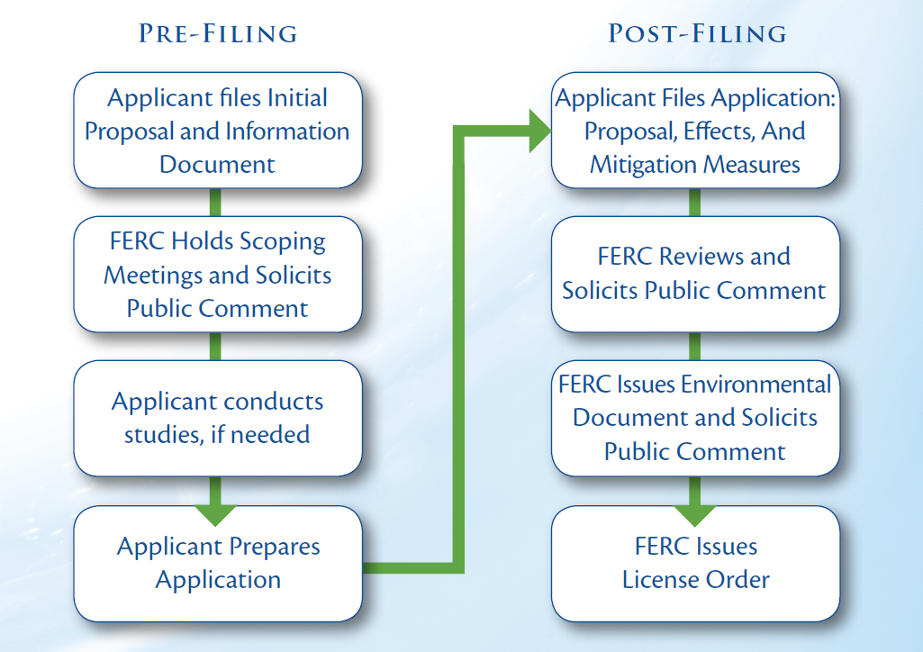
Notes:
Pre-Filing: identify and obtain information needed to inform review of the proposed project’s benefits and impacts
Includes a scoping process and studies to obtain the information necessary to evaluate the project
Post-Filing: uses the information gathered during pre-filing to determine whether it’s appropriate to issue a license and determine what mitigation measures to include in the license
Includes FERC’s evaluation of the license application and preparation of environmental documents required under NEPA

Slide 5
Pre-Filing Activities
Notice of Intent to File an Application and Pre-Application Document
Describes the proposed project and information about the project’s effects
Tribal consultation
Scoping
Identify environmental issues and determine what studies are needed to better understand these issues
Comment period
Study requests
Notes:
Pre-Application Document:
Describes the proposed project and information about the project’s effects
At this point, applicant not required to undertake studies, but must exercise due diligence in gathering existing information related to the project, this includes outreach to those that may have relevant information
Consultation: within 30 days after the notice of intent, FERC staff required to consult with each Tribe likely to be affected by the proposed project
Scoping: process for identifying environmental issues and studies needed to fill information gaps related to those issues
Scoping process is also used to determine the scope of issues to be addressed in FERC’s environmental review required under NEPA
Includes a public comment period on the Pre-Application document
Other agencies, Tribes, FERC staff, and the public can also request that the applicant conduct specific studies to address information gaps

Slide 6
Pre-Filing Activities (cont.)
Study Plan Development
Proposed Study Plan and comment period
Revised Study Plan
FERC’s Study Plan Determination
Study Dispute Resolution Process
Study Implementation
Study Report and meeting
Notes:
Study Plan Development: opportunities for engagement to influence the development of studies the applicant is required to undertake
Proposed Study Plan: details the applicant’s proposed studies for evaluating the feasibility of the proposed project and its potential impacts
Applicant must explain how the proposed studies address the issues raised during scoping and how the proposed studies will fill the information gaps identified
If the applicant decides not to adopt a study requested during scoping, the applicant must explain its decision
90-day comment period on the Proposed Study Plan, which also provides an opportunity to submit revised study request
FERC’s regulations require at least one study plan meeting be held to discuss proposed studies and information needs
Revised Study Plan
Within 30 days of the end of the comment period on the Proposed Plan, the applicant must submit a revised plan
Must respond to comments, including any agreements or continued disagreements with study requests
Brief, 15-day comment period
Determination
Within 30 days after the applicant submits a Revised Study Plan, FERC (Director of Energy Projects) must issue a Study Plan Determination
Approves the Study Plan with any modifications FERC deems necessary
The applicant must conduct the studies included in the approved Study Plan
If an applicant fails to conduct a study required under the approved plan, the license applicant may be considered deficient
An applicant can decide to conduct additional studies, beyond what is required under the Study Plan
Dispute Resolution
Formal process to resolve disputes arising from rejected study requests
Participation in this process is primarily limited to federal land management agencies and other entities with authorities related to the license
Study Implementation
Studies generally take one to two years to complete
During implementation of the Study Plan, the applicant is required to submit progress reports
Reports must describe the information gathered and any proposed modification to the Study Plan
In conjunction with the Study Reports, the applicant must hold a meeting to discuss the study results

Slide 7
Pre-Filing Activities (cont.)
Preliminary License Proposal
Project facilities
Project operations, including mitigation measures
Environmental analysis
Draft License Application
Includes all elements of the license application
Notes:
Final step in the pre-filing process
Applicant can submit a Preliminary License Proposal or a Draft License Application
Preliminary License Proposal contains many of the same components as a license application and a draft application include all the same components as a license application
90-day comment period
Comments may include recommendations on what level of analysis FERC should undertake to fulfill its NEPA obligations (whether FERC should develop an Environmental Assessment or a more comprehensive Environmental Impact Statement)

Slide 8
Post-Filing Activities
License Application
Project facilities and operation
Existing environmental resources
Effects of the project
Proposed mitigation measures
Environmental Analysis
License Decision
Notes:
License Application
FERC reviews the application to ensure it is complete and no additional information is needed
Once the application is accepted as complete, FERC seeks comments on the application before performing the environmental analysis required under NEPA
Environmental Documents
The type of environmental document FERC prepares is determined based on the level of impacts of the project
Typically, FERC develops an environmental assessment
If FERC staff determines that there would be a significant effect on the quality of the human environment, Commission staff must prepare an environmental impact statement
Another opportunity to submit comments on the environmental documents
Licensing Decision: FERC determines if it’s appropriate to issue the license and what environmental measures should be included in the license
Decision based on comments and environmental documents. In deciding whether to issue the license, FERC must consider more than the power and development purposes for the license
FERC must also give “equal consideration” to
purposes of energy conservation,
the protection of fish and wildlife (including related spawning grounds and habitat),
the protection of recreational opportunities, and
the preservation of environmental quality
Does not give environmental consideration veto power in FERC’s licensing decision, but requires FERC to balance power and non-power values

Slide 9
Nuyakuk Hydroelectric Project – Timeline
October 2019: Notice of Intent and Pre-Application Document
November 2019: FERC initiates scoping (single scoping meeting in Anchorage)
March 2020: Proposed Study Plan (two virtual Study Plan meetings)
June 2020: Request to place process in abeyance
March 2022: Updated Proposed Study plan and request to reinitiate process

Slide 10
Nuyakuk Hydroelectric Project – Timeline
June 30, 2022: deadline for comments on Proposed Study Plan
Proposed schedule (approved by FERC) does not include Proposed Study Plan meetings
July 2022: Revise Study Plan
August 2022: FERC Study Plan Determination
Study dispute resolution process
2023 and 2024: Study seasons (study report at end of each study season)
January 2025: Preliminary Licensing Proposal (FERC staff estimate)

