Slide 1
Why We Hurt
The Ongoing Impact Of Historical Trauma In Bristol Bay
&
Community Solutions for The Next 500 Generations

Slide 2
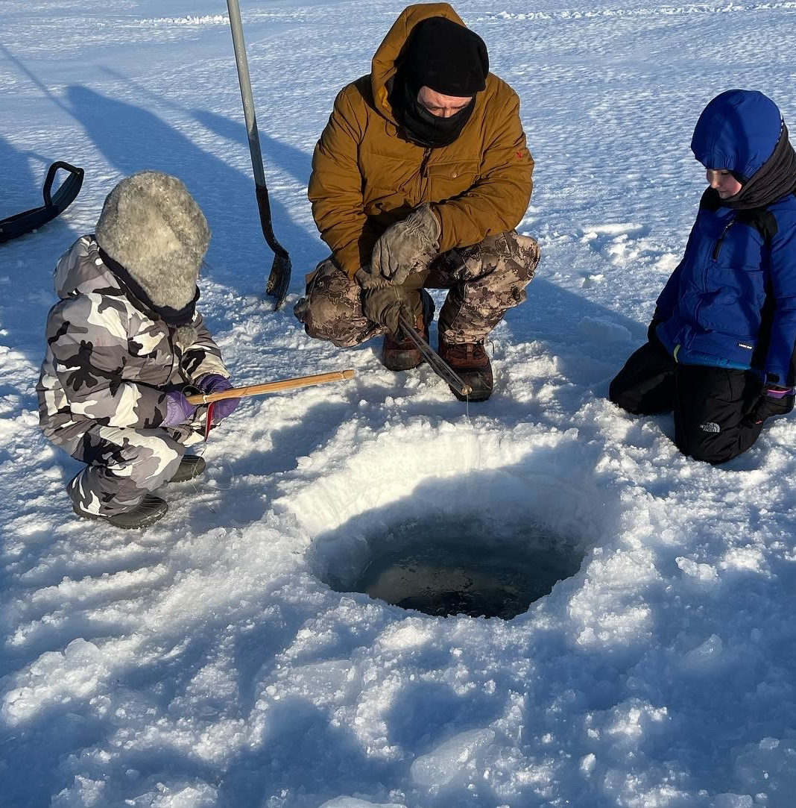
Who We Are
Notes:
We are human beings. We are survivors. Moment of silence of those we lost. We uplift the memory of those who we lost and we do this work so that we don’t lose any more of our people. Why do we need to know this – We need to understand why we need to make changes to heal our people.

Slide 3
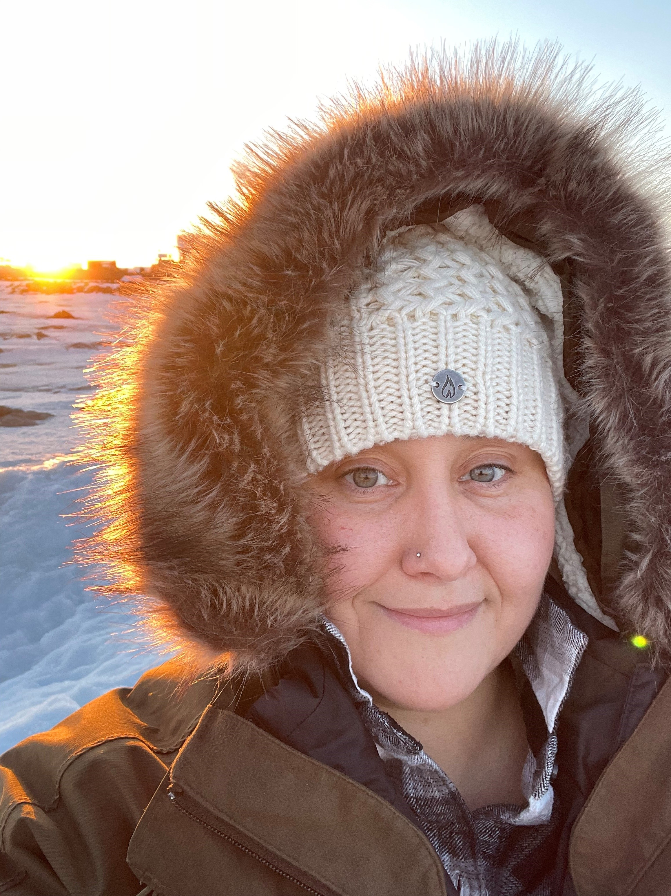
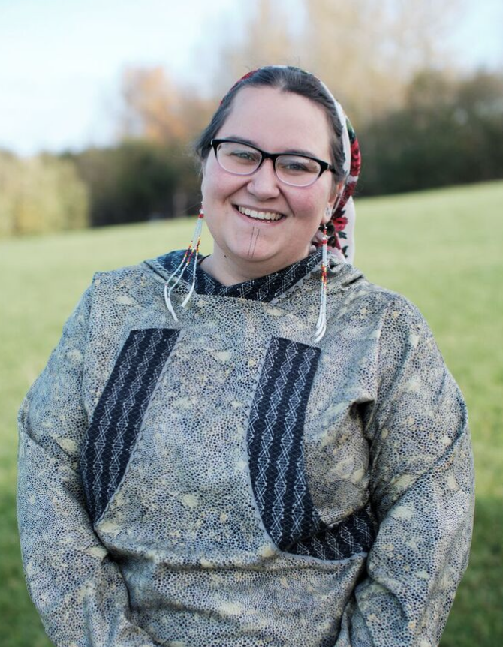
Christina Love
ANDVSA Senior Specialist
Tiffany Webb
Opioid Prevention Coordinator
Amber Webb
MMIW Advocate, Cultural Expert, Peer Work Coordinator
Notes:
Amber Introduce Tiffany
Tiffany Introduce Christina
Christina Introduce Amber

Slide 4
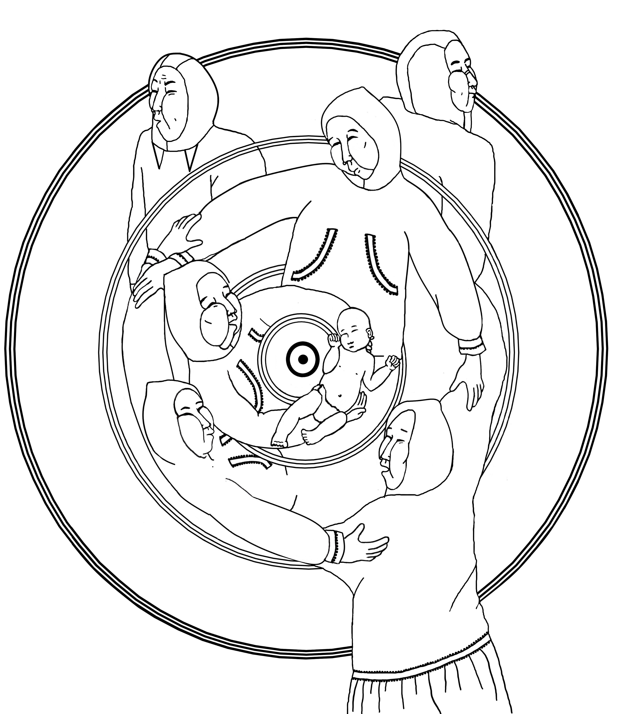
THE YUPIAQ COMMUNITY STRUCTURE
Yua or Ellem Yua (Spirit/creator) at the center
Children closest to spirit
Elders teach and connect with children
Female Identifying relatives care for community and provide
Male identifying relatives protect and provide
Every person is important and valued
Citation: Concepts borrowed from YKHC Calricaraq Program
Notes:
Imagine how it would feel to be inside this circle. Nothing came in or out of this circle without our men knowing about it.

Slide 5
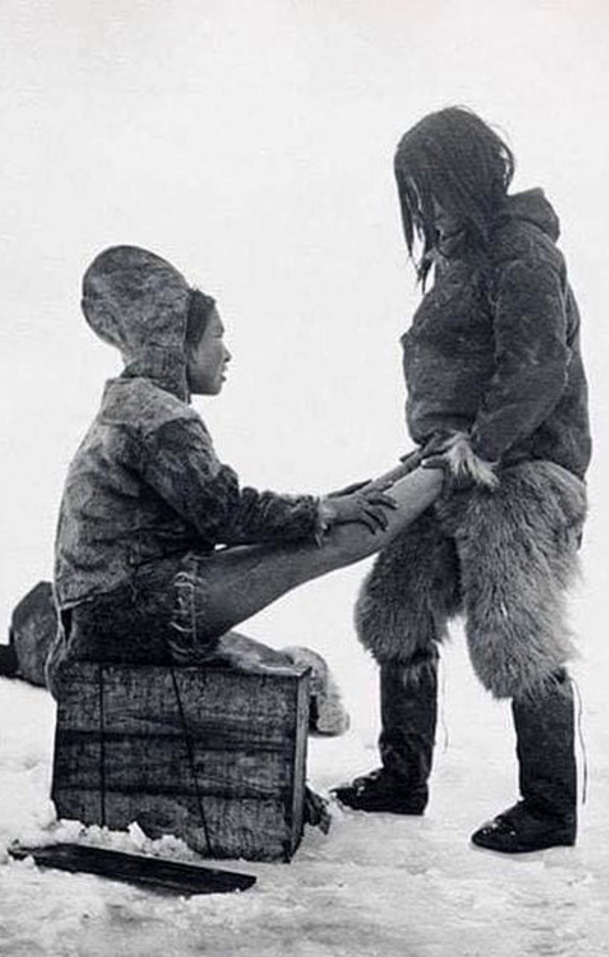
CALRICARAQ – THE WAY TO HEALTHY LIVING
Our ancestors passed down teachings that were a gift from the creator so that we could live well. They were taught by example and with stories.
Kenka- Unconditional Love as a way of being
Naklegtaq kusgurtaq– Being Empathetic
Tuvqataq- Being Compassionate
Takumcutaq- Being Sympathetic
Patagavkenani- Having Patience
Anglanilleq- Natural Laws Of Life
Qanruyun- How to Be
Ayuqucirtuun- Humor Provoking Joy
Citation: Concepts borrowed from YKHC Calricaraq Program
Notes:
We have other words in our region for how to live healthy, but this word is very old. When the Kuskokwim elders worked with Rose Domnick to develop the Calricaraq program, they said that these teachings are a gift from creator so that we can live good lives. All of our indigenous cultures have similar teachings about how to live healthy. They had to heal from the pain of being told our traditional teachings were evil and a lot of them had not used this word or heard it spoken since they were young children.

Slide 6
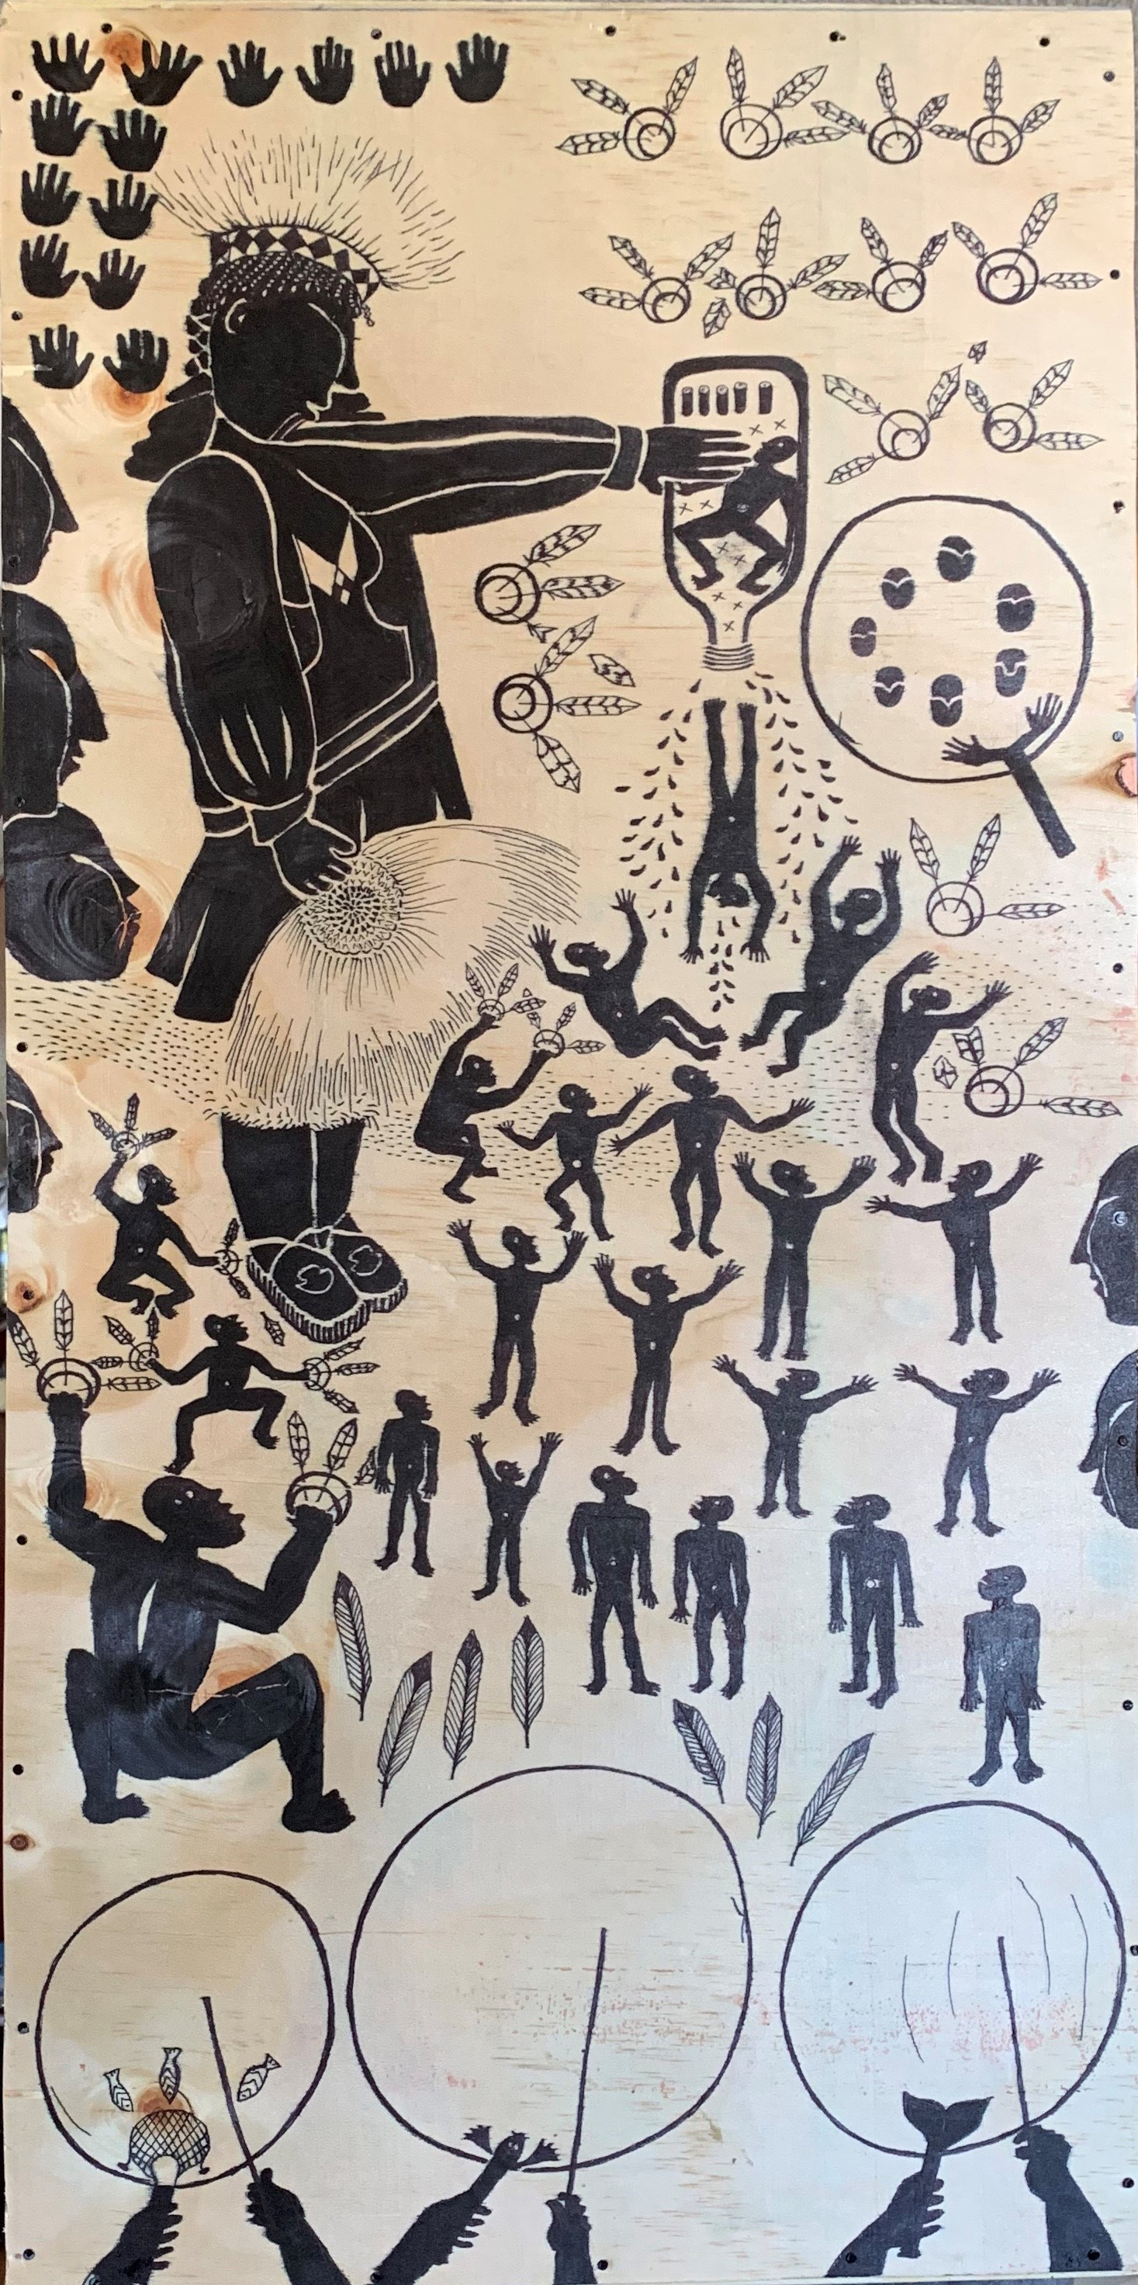
CULTURE IS:
Healing
Prevention
Resistance
Resiliency
Protective
The application of thousands of years of “evidence-based practice”
Citation: SAMHA – Culture Is Prevention, 1999
Citation: Tucker Walters & Beltran, 2015 and 2007
Citation: Gordon, Him & Jordan, 2022
Citation: Braveheart, Chase, Elkins, and Altschul, 2011
Citation: Yamane & Helm, 2022
Notes:
Best Practices
We are grateful to all of the people who kept speaking our languages, telling our stories and teaching our dances so that we have them to share with future generations.

Slide 7
“We instill in them a pronounced distaste for the native life so that they will be humiliated when reminded of their origin. When they graduate from our institutions, the children have lost everything Native except their blood.”
– Bishop Vital Grandin, 1875

Slide 8
THE INTENT OF THE DOCTRINE OF DISCOVERY/ DOMINATION WAS TO ACQUIRE LANDS
The original language is based on the concept of terra nullius meaning vacant lands. The meaning was re-interpreted to land not occupied by Christians after Columbus sailed to North America and found that there were people occupying those lands
Pope Nicholas directed King Alfonso to “capture, vanquish, and subdue the saracens, pagans, and other enemies of Christ,” to “put them into perpetual slavery,” and “to take all their possessions and property”
The ideology supported dehumanization of people living on their homelands
Murder - Torture
Forced-assimilation - Dispossession
The Doctrine of Discovery became the foundation of US and international law used to justify the extermination of native people.
The Doctrine of Discovery inspired the Monroe Doctrine in 1823 which declared dominance over the western hemisphere including the concept of manifest destiny that justified westward expansion because it was “sanctioned by God.”
Notes:
Discovery being a synonym for domination. The people who became known as the founding fathers believed that God meant for them to take the land. The reason they believed that is because of the premise that native people were sub-human. Native were forced to accept Christendom, but would never become fully human within this system. This system persists in US government policy and the legal system.
John O Sullivan came up with the term Manifest Destiny and

Slide 9
Notes:
Our hospital originated in colonial trauma. In order to care for our people, we are responsible for looking at how this persists and then take actions wherever we can to change it.

Slide 10
TRAUMA RESPONSE WARNING

Slide 11
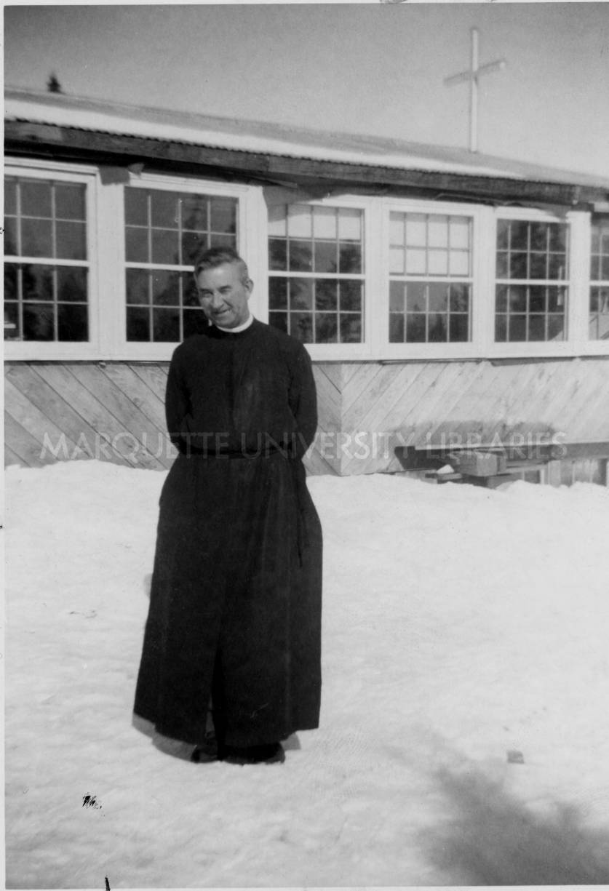
VIOLENCE IS A LEARNED BEHAVIOR
Violence is a learned behavior passed down in families in our region over the last 200-300 years
Settlers/Colonizers were our first abusers
Western culture does not honor the environment, women, children, elders, differently abled or lgbtq+ people, community orientation, or our original spiritual practices
There were no words for rape or child abuse in Yugtun before contact
Sexual violence, racism and adverse childhood experiences cause high rates of substance use disorder, suicide, eating disorder, cancer, diabetes, heart disease, depression, anxiety and incarceration
We were healthy for 10,000+ years before contact

Slide 12
COLONIZATION IS UNNATURAL
They took our bodies – sexual violence as a war tactic, enslavement and trafficking starting with first contact.
They took our land – Land was claimed for the fur and fishing industries without considering traditional land use patterns. Today, native allotments can be sold to non-native people and are thereby stolen from the next 7 generations of our children, often through poverty- driven coercion. Part of the process of erasure.
Blood Quantum – disrupting our natural ways of being and replacing them with systems of violence that are designed to erase us.
They took our stories – the story they tell about us is not right. They severed the connection between youth and elders in boarding schools so that our oral history and language were not passed down.
They took our ways of parenting – sold it back to us as attachment / gentle parenting.
They took our language – we are charged to attend universities to relearn our language after our parents and grandparents were beaten and humiliated for speaking it.
They took our resources –The state of Alaska Department of Fish and Game does not consider moose or caribou a subsistence food. We need to ask for permission to feed ourselves. We apply for competitive grants to fund public health programming that is often not accessible to our rural people.

Slide 16
WHEN WE DON’T HAVE THE TOOLS OR WORDS TO SAY WHAT WE NEED, OUR BEHAVIORS TELL A STORY FOR US
We need to:
Understand the ways people survive suffering.
Validate, normalize, acknowledge, witness, hold (catch people’s words and not let them drop).
Recognize that we are responsible for unlearning our beliefs and behaviors that perpetuate harm rooted in historic trauma.
Acknowledge how our systems perpetuate abuse and embrace change.

Slide 17
NATURAL REACTIONS TO TRAUMA –WAYS WE PROTECT OURSELVES TO SURVIVE
We all do the best we can until we know another way. We may mistake survival tactics with behavioral issues.
Inability to trust others - People have to work harder to earn trust because of lifetime experiences/generations of harm.
Assuming responsibility for too much- Damage to traditional community structure prevented those reciprocal family systems from functioning. Caused by lack of connection to community and culture. Being afraid to depend on others – We couldn’t depend on others because they were experiencing their own trauma. Assimilating to a culture rooted in power and control.
A burning need to be in control – The brain’s protection against feelings of powerlessness associated with harm.
Denying problems – The brain and body’s subconscious inability to acknowledge and process an individuals own suffering because of a lack of resources and support. Implications in relationships: If I can’t acknowledge my own, I can’t see it for other people either. Brain may preserve primary relationships – my mother/father/auntie/uncle/grandparent caused trauma, but they were also someone I has a secure attachment with. The brain subconsciously preserves that attachment for survival.
Citation: Native Wellness Institute’s 21 Behavioral Characteristics of Trauma Survivors handout developed by Jane Middleton Moz

Slide 18
NATURAL REACTIONS TO TRAUMA –WAYS WE PROTECT OURSELVES TO SURVIVE CONT.
Seeking to be in chaos and drama – Violence is normalized and a consistent part of our lives by design. It was introduced on a massive scale and it continues today. Multiple intersecting levels of violence – Individual/internalized, interpersonal, community, institutional, policy, laws- sanctioned. The absence of it can be uncomfortable. We are targeted.
Being unable to relax, let go and have fun. – The bridge for empathy is missing for us – resiliency (being in survival mode) means there isn’t room for rest or ease. No vacation from pain, suffering.
We are either grieving a death, navigating multiple crises – individual, community and collective. Constantly facing erasure and genocide, health issues connected to our own trauma.
The need to be right- perfectionism rooted in compliance with assimilation abuse and compliance with individualism.
A deep sense of injustice- A normal response to oppression. We continue to feel/see the impact of oppression in our daily livesut may not have the internal resources to name it and release it. We cannot confront the people/systems who hold power over us and cause harm, so we vent it on each other. When this happens, it is called Lateral Oppression.
Rage – Part of the “fight” trauma response. The limbic system can hijack our brains.
Citation: Native Wellness Institute’s 21 Behavioral Characteristics of Trauma Survivors handout developed by Jane Middleton Moz

Slide 19
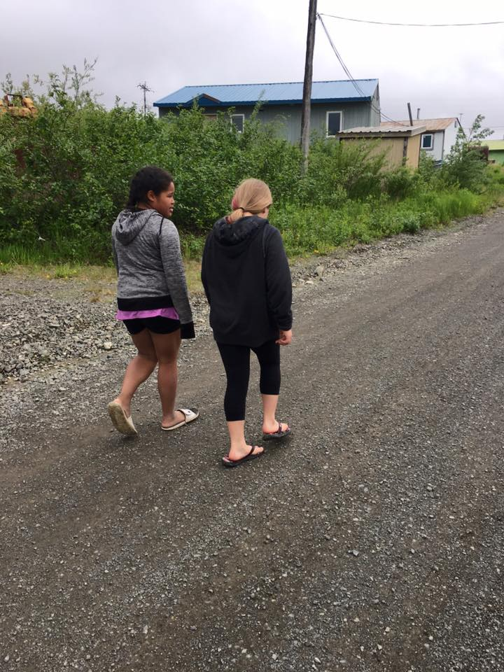
QARUYUN
Qaruyun is traditional Yupiaq medicine used to help another human being accept and become whole again
It means to sit with another person and listen with out judgement to help them draw out their pain so that they can heal
It is a Yupiaq teaching that encompasses empathy and compassion
Qaruyun is evidence that peer support and harm reduction have always existed in Yupiaq cultural practices

Slide 20
INVESTING IN COMMUNITY – HIRING LOCAL
We need to see people who look like us and who have lived like us
Hiring local keeps money in the community
Hiring local increase staff retention
Hiring local allows community members to provide for their families
Income is a valuable part of healing and being able to provide for your own needs is part of restoring reciprocity
Bringing in outsiders perpetuates violence in many instances
They may not see our solutions
They often block our pathways to traditional community structure
All healing work must be led by those impacted

Slide 21
BARRIERS TO HIRING LOCAL PEOPLE
Prioritizing western pathways to education over traditional/ancestral knowledge and teachings –perpetuates internalized oppression/racism
Degree requirements for positions of authority prioritized over demonstrated skills in the workplace and community
Practices of academic systems are sometimes in opposition to cultural knowledge and customs – We have 10,000+ years “evidence-based” practices
Community/workplace disfunction deters people from applying
Lack of housing for returning college graduates
Barriers to professional development
Racism – constant pressure has an impact on all aspects of health.
History of incarceration – a direct result of oppression and systemic violence
Notes:
Collateral Consequences of Intersectional Systemic Discrimination and Racism. Equity is both a process and an outcome. We center the experiences of those affected in everything we do.

Slide 22
INVESTING IN LOCAL HIRES THROUGH ORGANIZATIONAL TRANSFORMATION
Happens on multiple levels and is person centered / person lead
Anti-oppression
Addressing oppressive patterns and policies in the workplace contributes to healthier employees /healthier communities
Addressing internalized and lateral oppression contributes to healthier families and communities
Anti-racism
Encouraging organizational accountability is a part of healing.
Improving behavioral health in the workplace perpetuates community health
Native people deserve to feel valued for their skills and paid fairly for their expertise
Notes:
Connect Each One of Us To an Ask. Connect asks to strategic plan. Pathways for professional development. Stevi’s Story

Slide 23
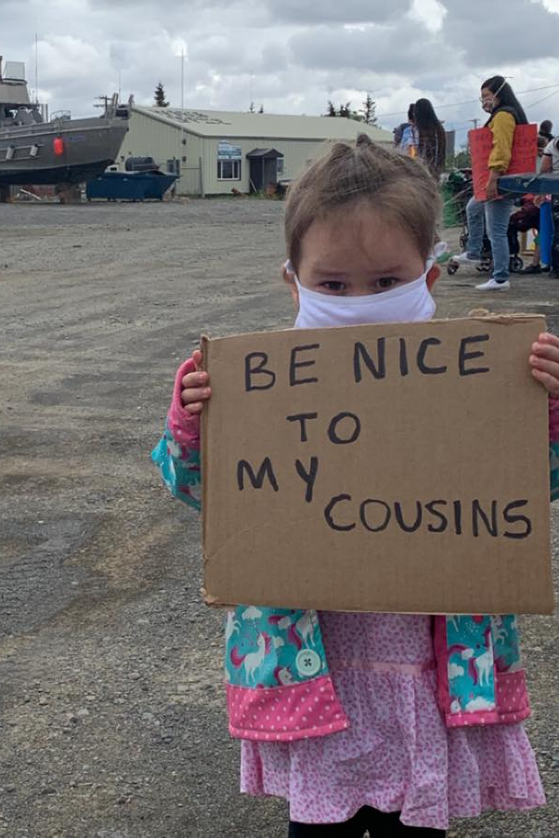
HARM REDUCTION
Harm reduction is only controversial when people don’t understand the connection between trauma/pain and addiction
Harm reduction keeps people alive - If people are alive, they can get help
Policy
Variance Process
Equity Assessment
Workforce development
Practice
Peer support
Traditional healing
Indigenize in every way we can
Notes:
Moment of silence for those we have lost. Ask Board Members to do a visualization of hope for someone they love who is struggling

