Slide 1
Community Planning, Needs Assessment and Grant Writing
Shanna Zuspan, AICP
Tanya Iden, AICP
Bristol Bay Sustainability Summit
March 23, 2022 | 10:00 – 11:00 am

Slide 2
Land Acknowledgement
We would like to acknowledge the original Yup’ik, Dena’ina, and Alutiiq custodians of the land on which we are meeting today.
We would also like to pay our respects to the elders of this area – past, present and emerging.

Slide 3
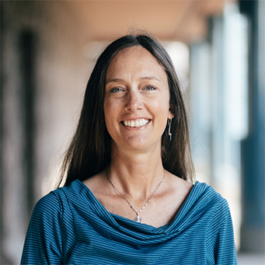
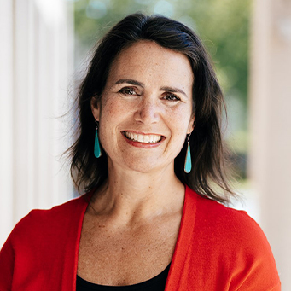
Who We Are
Shanna Zuspan
Principal:: Owner
Agnew::Beck
Tanya Iden
Principal:: Owner
Agnew::Beck

Slide 4
Today’s Agenda
Community Planning
Where is your community headed and what are the priorities?
Needs Assessments and Feasibility Studies
Does the data support the need for a project? Is the idea sustainable?
Funding Opportunities & Grant Writing
What funding can we bring to the table and what sources make sense to apply for?

Slide 5
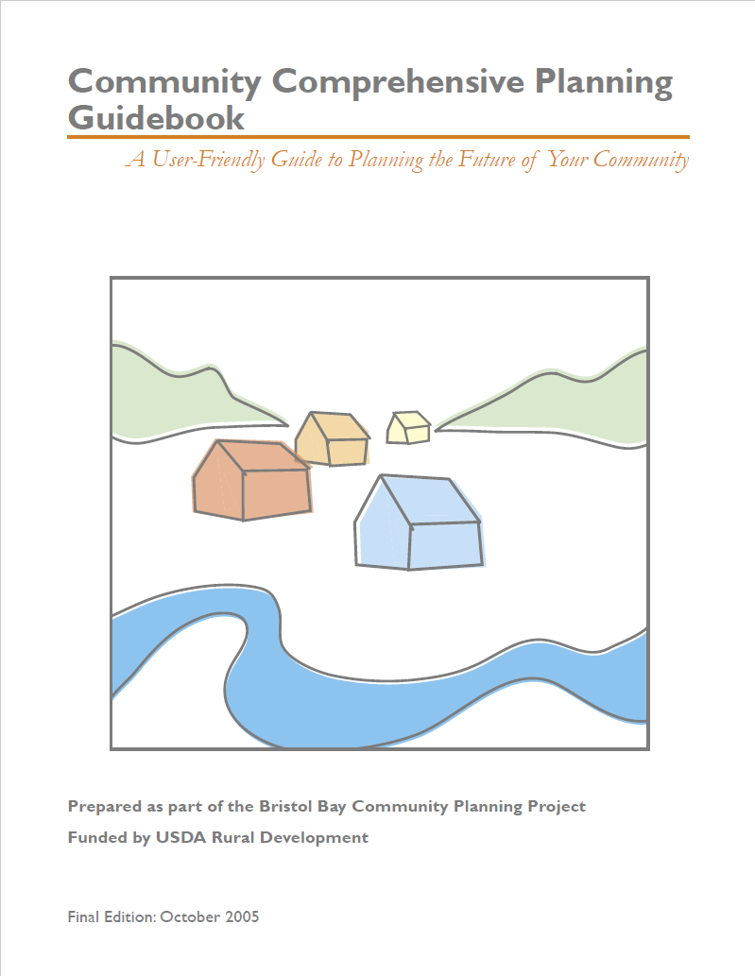
Community Planning
Notes:
importance, how to do one (20 minutes)

Slide 6
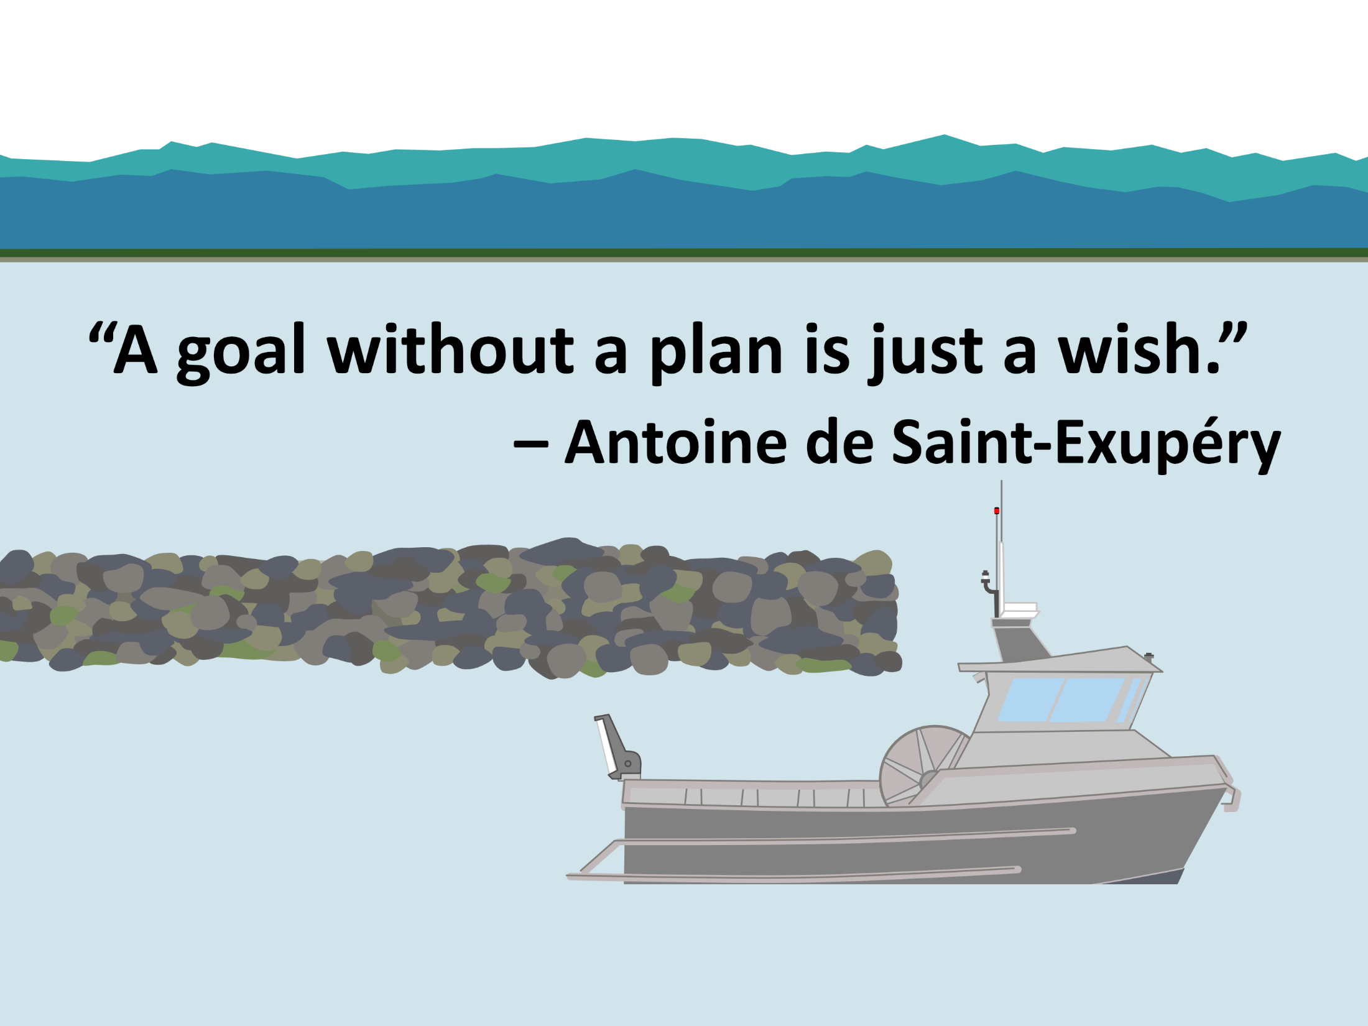

Slide 7
Why is a community plan needed?
To guide decision-making on topics such as land use, wellness, economic development, transportation, community facilities, infrastructure and housing
To create a common set of priorities
For the City and Tribe to access funding for services and infrastructure

Slide 8

What is a Community Plan?
A community resource and tool to guide community and Tribal leaders, residents, organizations, businesses, funders and other partners
A community plan includes:
long term vision, goals, and practical short-term strategies
polices that protect what residents value and enhance the quality of life for current and future residents

Slide 9
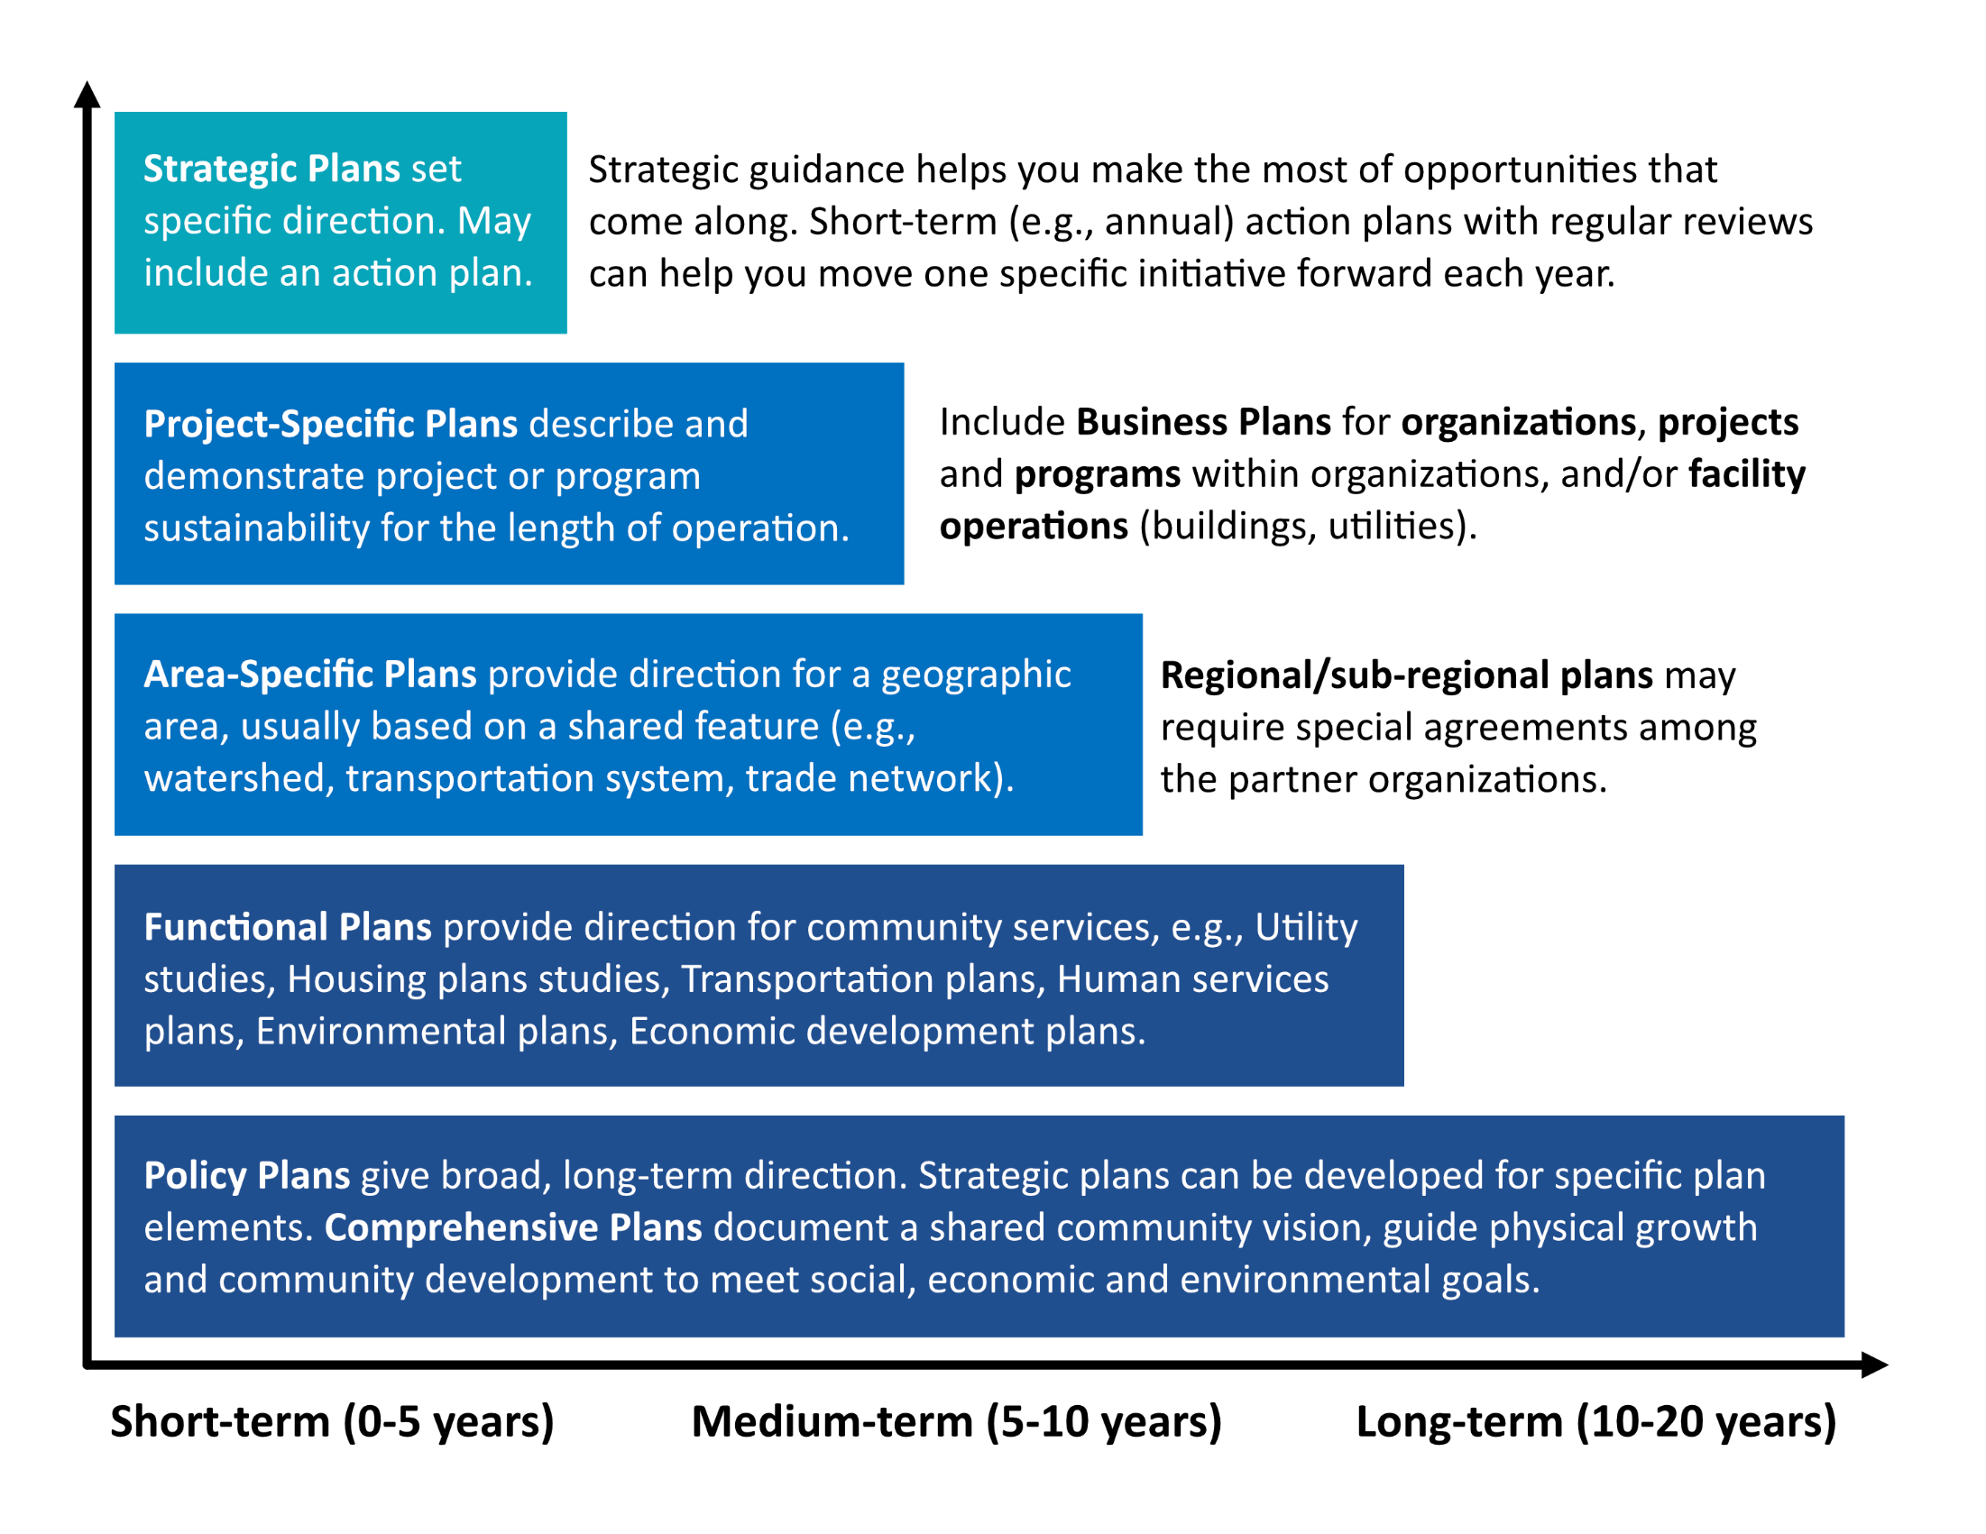

Slide 10
What is a Comprehensive Plan?
Alaska Statute, Title 29. Requires Planning
Cities and boroughs must engage in some form of land use regulation, including platting authority
AS 29.40.010(a). Planning Platting, and Land Use Regulation
AS 20.40.030(b). Comprehensive Plan
  (a) The comprehensive plan is a compilation of policy statements, goals, standards, and maps for guiding the physical, social, and economic development, both private and public and may include, but is not limited to, the following:
  (1) statements of policies, goals, and standards;
  (2) a land use plan;
  (3) a community facilities plan;
  (4) a transportation plan; and
  (5) recommendations for implementation of the comprehensive plan.

Slide 11
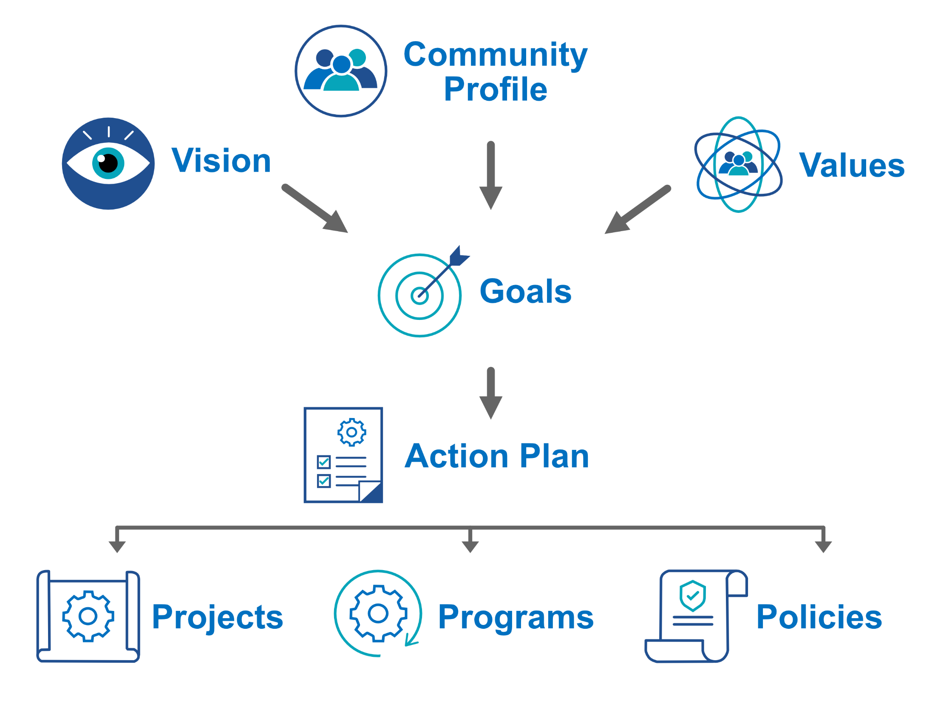

Slide 12
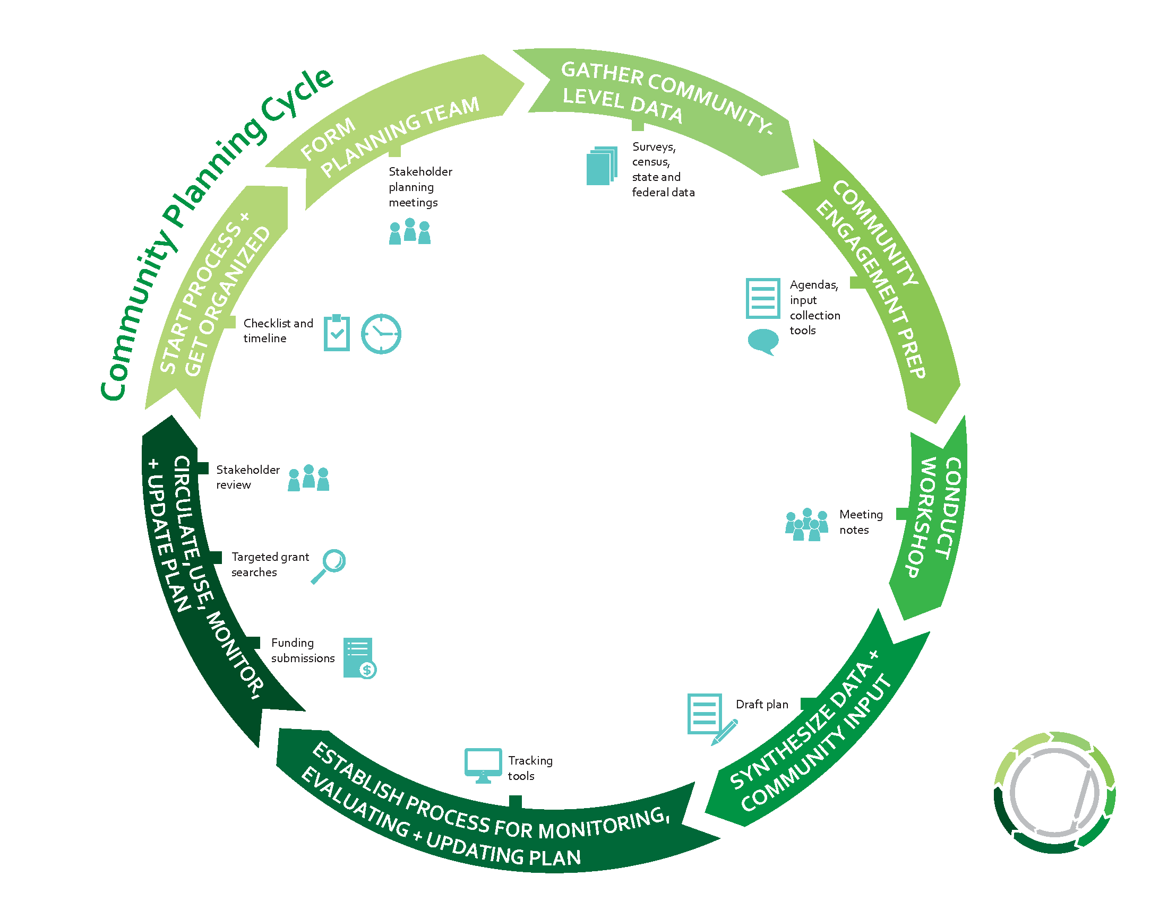
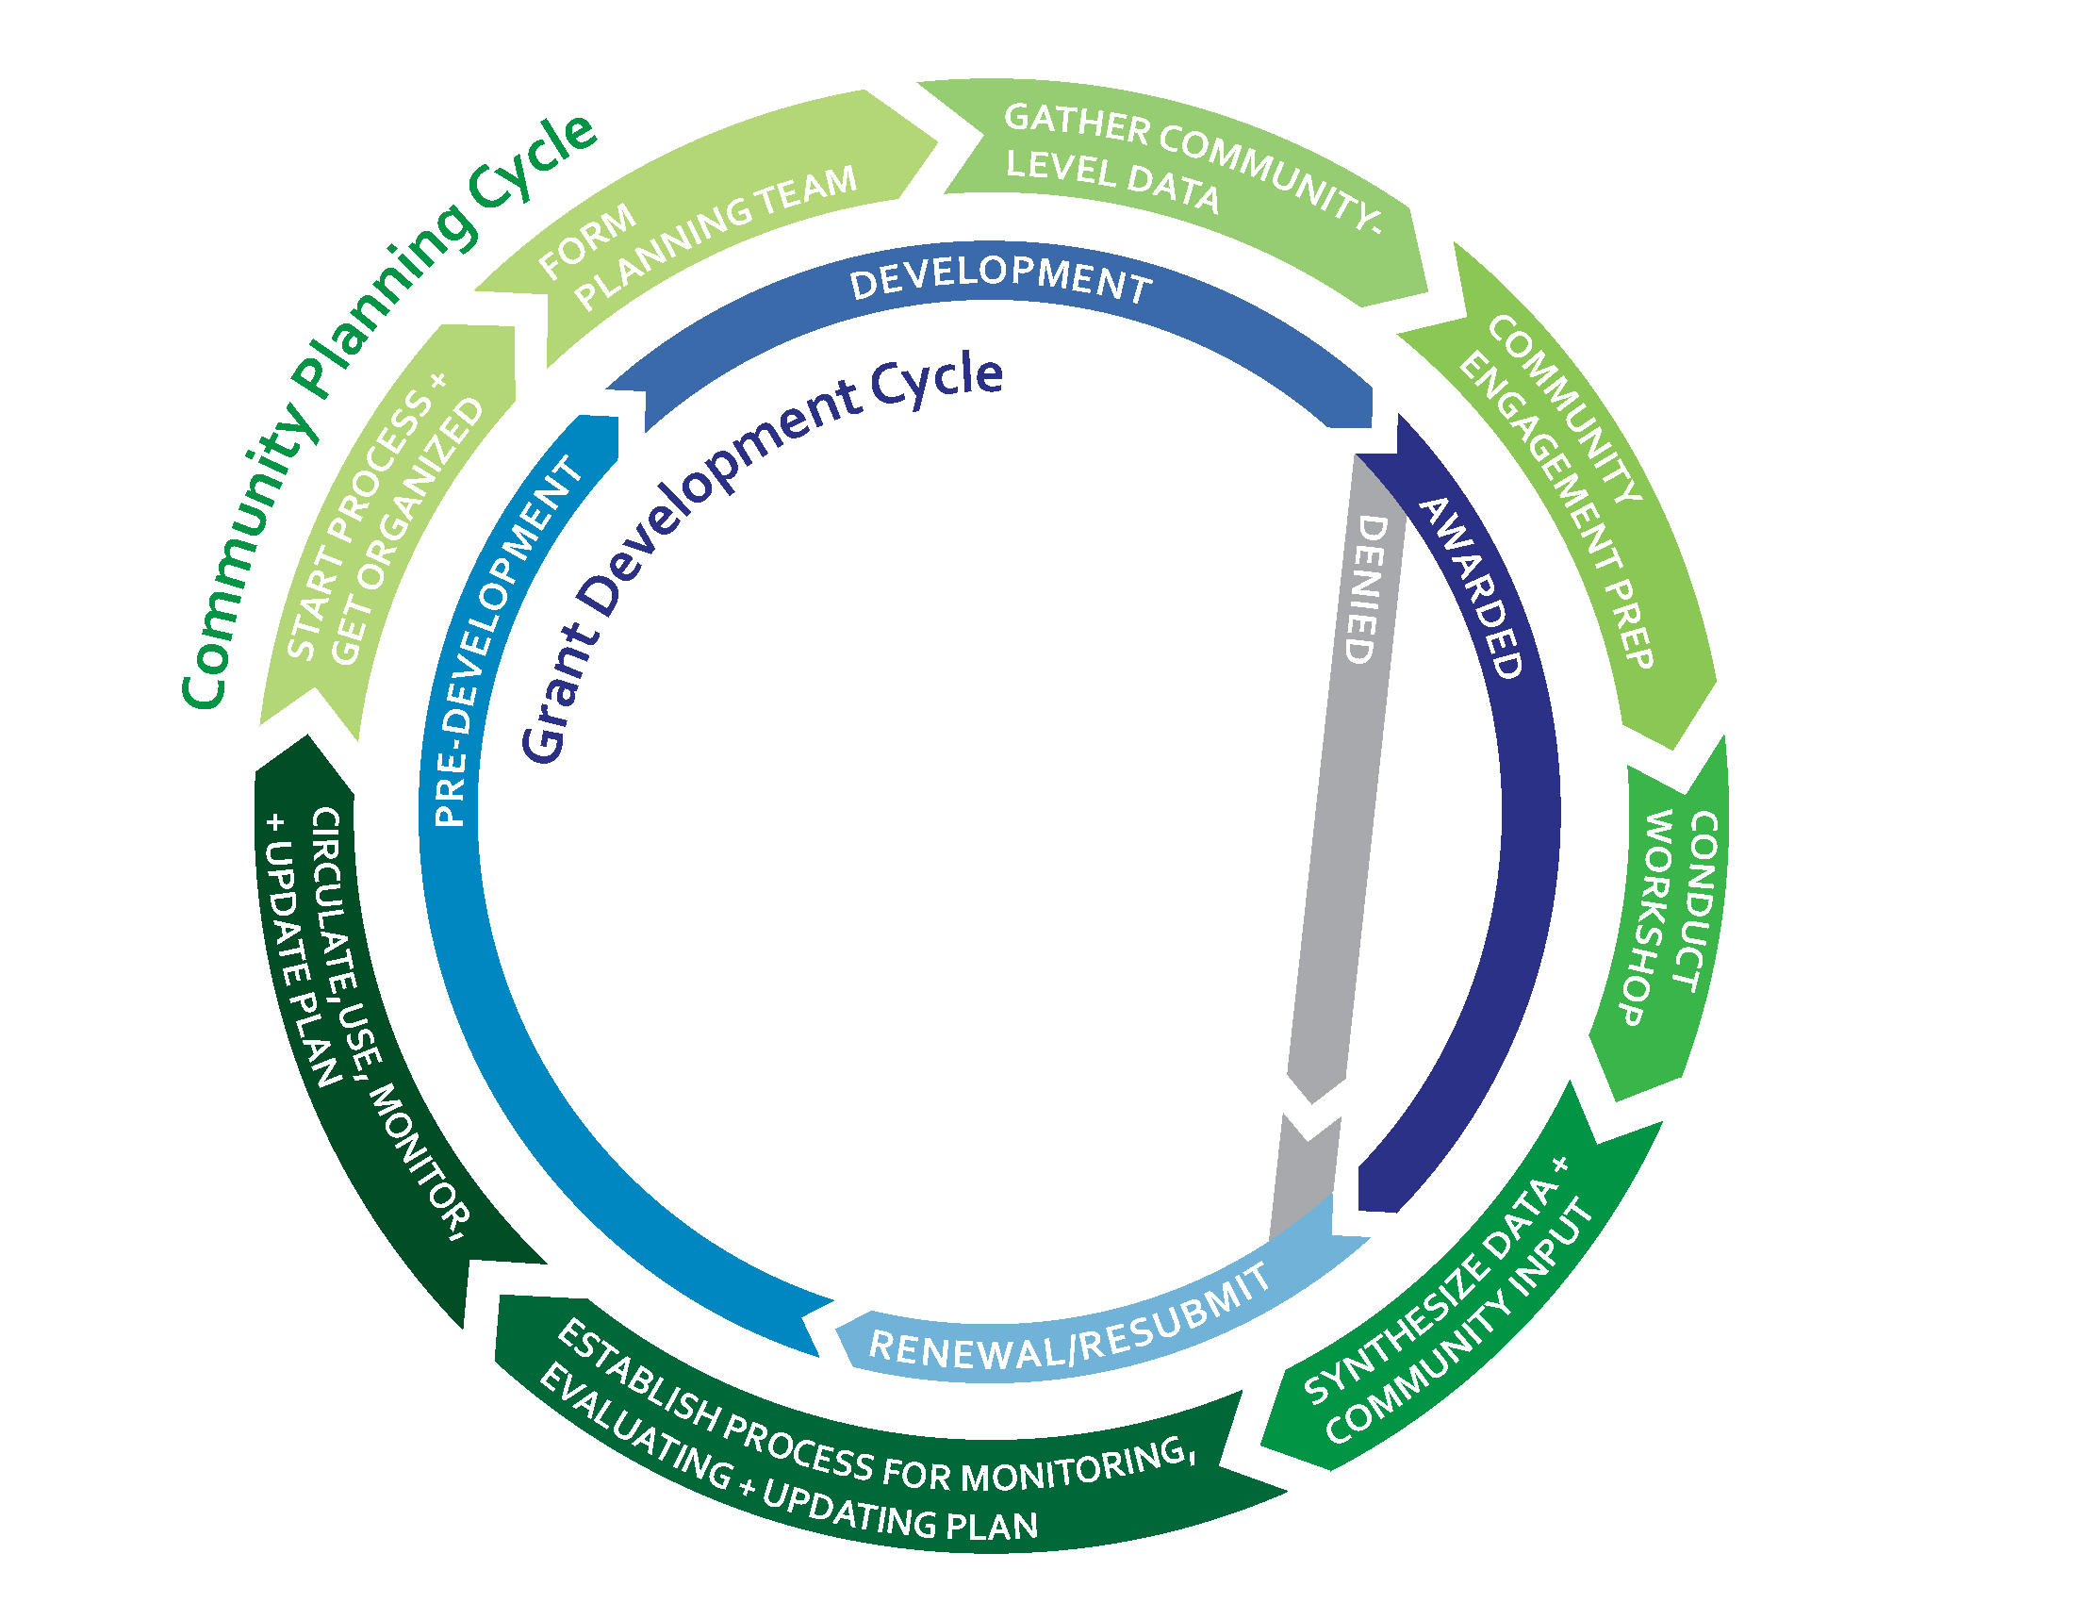
Agnew::Beck
12
Notes:
Page 4

Slide 13
Components of a Community Plan
Vision
What are we working toward? Where do we want to be in 10 years?
Mission
What do we do and who do we serve?
Values
What do we care about? What is important to us?
Goals
Broadly, what are we hoping to accomplish? In what areas do we want to see improvement?
Strategies
How are we going to make progress? What is needed to achieve our goals?
Outcome Measures
What measurable progress do we want to see?
Action Plan
How will we make progress on priority strategies?
Timeline
What is the timeline for implementation?

Slide 14
Community Planning Process Example
Gather Background
Interviews (leadership, staff, key partners)
Review related plans, documents, community data
Hold Work Session(s)
Reflect on background findings
Prioritize strategies
Finalize
Incorporate results from work session
Adopt, implement, evaluate
Synthesize
Interactive activities
Identify strengths, weaknesses, opportunities, threats (SWOT)
Prepare an initial list of goals and strategies
Prepare action plan
Community survey
Customize to fit your community and to the resources you have available

Slide 15
Vision, Mission – They are Different!
Mission
A statement describing the reason your organization or program exists, who you serve, and how you serve them.
Should answer the question: Who are we?
Vision
A statement describing inspirational long-term change resulting from your work.
Should answer the question: what are we trying to achieve?
Both should be
clear, concise (one sentence), memorable.

Slide 16
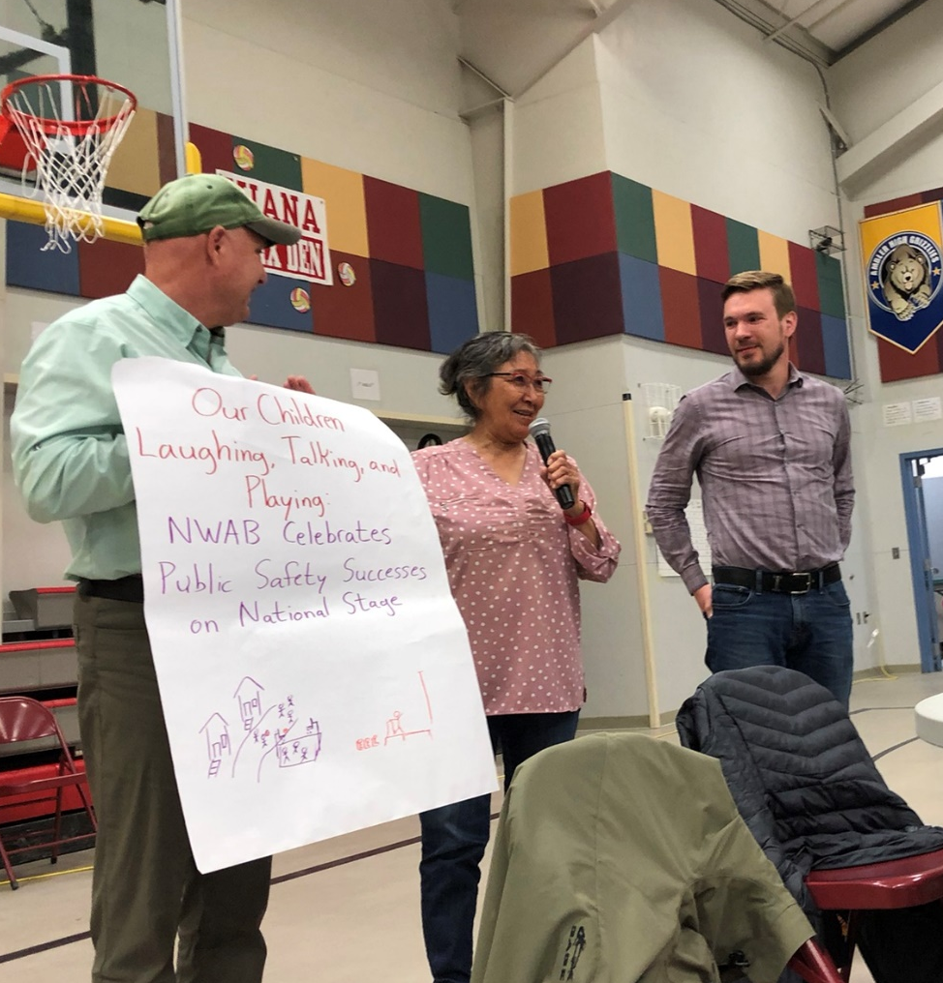
Vision Examples
We are a thriving Alaska community that embraces the small town, family-centered Christmas spirit. City of North Pole, 2016
A thriving, safe community with a high quality of life for current and future generations. City of St. Paul, 2020
Safe, healthy, thriving NAB communities and families. Northwest Arctic Borough Public Safety Department, 2022 draft

Slide 17
Aleknagik Community Vision, Update Underway
Aleknagik is a healthy and family-oriented community that continues to develop by…
improving infrastructure
diversifying the local economy
training the workforce
While protecting social and cultural values including…
a positive environment for families
opportunities for subsistence
preservation of natural resources and a pristine environment

Slide 18
Vision Activity: Our Community in the Future
Imagine that it’s 20 or more years in the future and our vision for our community has been achieved.
As individuals: Write the headline you would want to see on the cover of a local newspaper, or as the lead story on a local radio station.
As teams: Compare and combine your individual headlines into one shared headline and write on your flip chart paper.
  What are the words you would read or hear?
  Be creative – draw a picture!
  Tell us – Where exactly would you like the headline to appear?

Slide 19
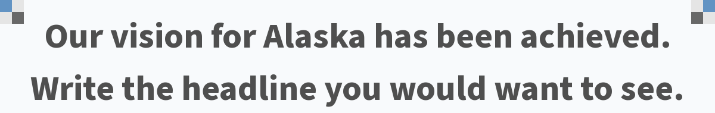
Alaska leads the way in addressing climate security, becomes the #1 climate refugee destination in the world. | The greatest place to raise a family
Alaska has achieved the goal of getting running water and sewer in every community. | Best Place to Live in the US
Alaska rebuilds economic value by expanding infrastructure, building new industry, and becoming desirable | Economic prosperity and opportunity
Alaska number one in workforce housing and economic development | Education
Average housing cost becomes affordable on a median household income | Alaska nominated as "best place in world"
Land rights have been rightfully returned to the indigenous inhabitants. | Alaska leads in attracting new talent!
Citizens Rejoice Over Shared Goals Met, and Prosperity Achieved | We're In
Alaska is in the top 5 states for economic growth in the country | Alaska is a land of opportunity!
Alaska becomes the first state to use 100% renewable energy. | Alaska becomes its own country
Great success in youth leadership and mentorship for Alaska | "Alaska tops economic charts"
Alaska shines as vibrant, diverse, richest and happiest state | Transitional Housing Complete!
Alaska leads the nation in renewable power generation | Opportunity for education, childcare, and housing
Alaska Finally Free from Outside Influence | Alaska Finally Qualifies for Free Shipping!
Alaska driving the world into the future.
Notes:
Poll Title: Do not modify the notes in this section to avoid tampering with the Poll Everywhere activity.
More info at polleverywhere.com/support
Our vision for Alaska has been achieved. Write the headline you would want to see.
https://www.polleverywhere.com/free_text_polls/oDCOLWUXfTsJcYzSQvpTo

Slide 20
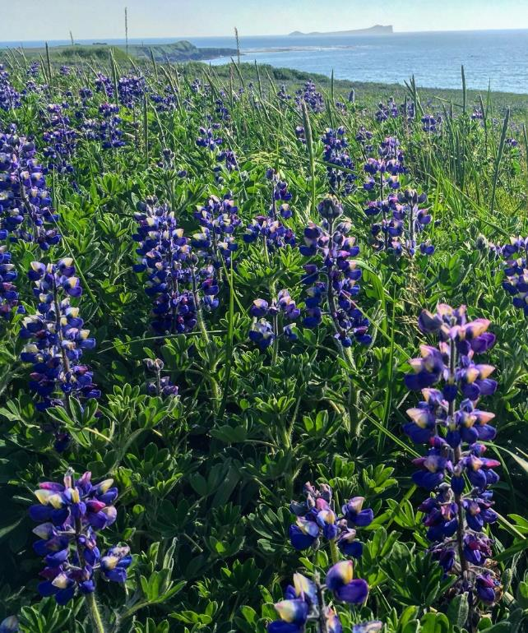
Core Values
What do we stand for?
What are our underlying beliefs and principles guiding leadership and staff?

Slide 21
Aleknagik Values
Our subsistence way of life
Understanding community
Planning for the future
Traditional activities
  Hunting
  Fishing
  Beading
  Berry picking
Education
Clean, healthy and natural environment
Family – children, parents, Elders

Slide 22
Core Values - Examples
City of North Pole
City of Saint Paul
Spirit of Christmas
Rural, independent character
Quality schools
Small-town feel
Thriving local businesses
Supportive, generous, friendly people
Conveniently located
Safety and security
Welcoming to the military
Living the Last Frontier
Accountability: we earn the trust of the community through transparent and responsive communications.
Quality: we take pride in our work and commit to being dependable and professional.
Resourcefulness: we seek out creative and cost effective solutions to address the challenges of remote Island living.
Respect: we are committed to positive and inclusive interactions.

Slide 23
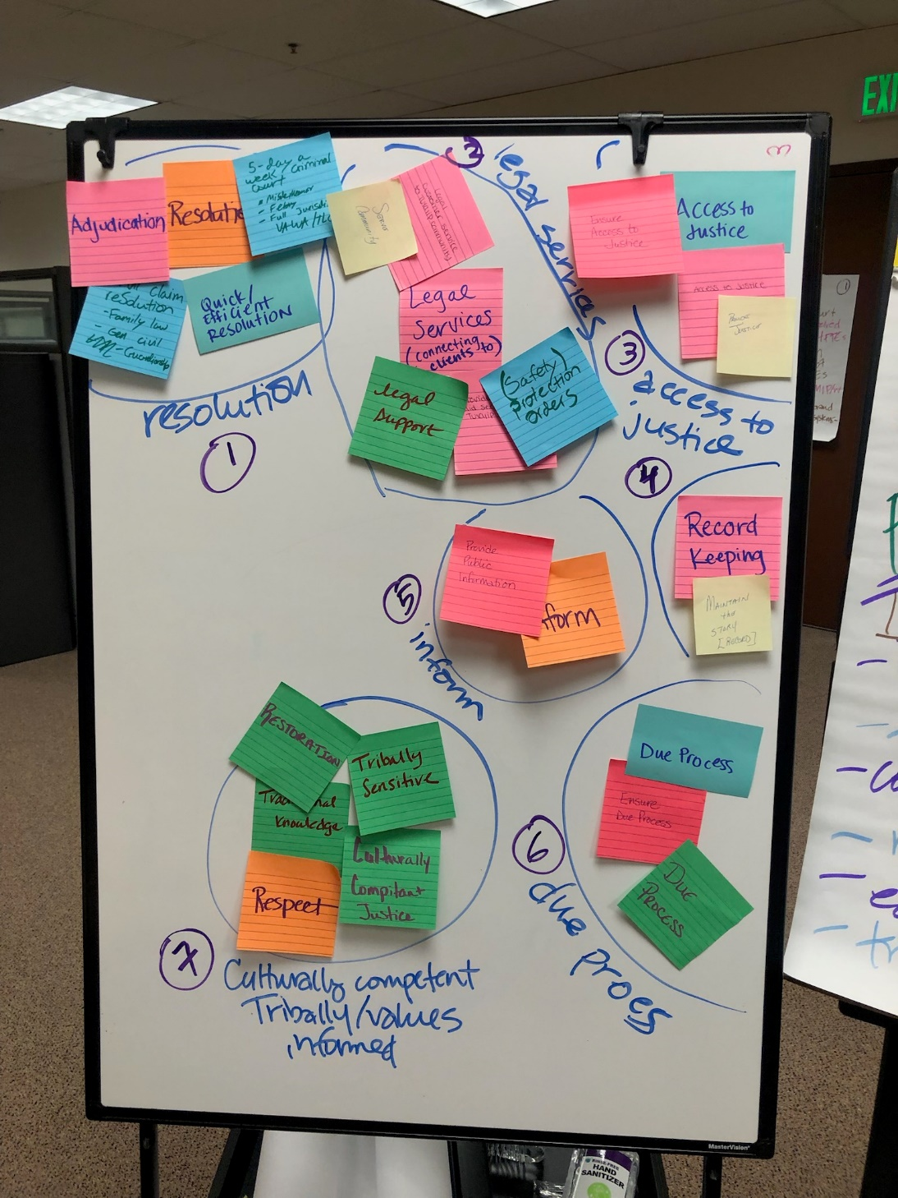
Core Values – sticky note activity

Slide 24
Strategic Planning as Teambuilding Opportunity – Example Activity
1. On a single sticky note:
Write 3 skills you bring to the team
(leave your name off)
2. Facilitator reads the results aloud, encourages folks to guess who submitted which sticky note
Benefits: celebrate your team; discover unique skills; elevate the attributes of individual staff

Slide 25
Example (names changed)
Alicia
Culture barer
Technical
Efficient
Brian
Grant writing
Legal knowledge
Verbal communication
Kelly
Mental health/therapy background
Good communication/coordination
Ability to think outside the box
Wendy
Historical knowledge
Criminal justice education
Service to community
Ben
Fast learner
Problem solver
Honesty/integrity
Fred
Problem solver
Enthusiastic researcher & writer
Experience with Tribes & Indian law
Dawn
Learner
Flexible
Written communication
Marcia
Good listening/ communication
Creativity
Multitasking
Sylvia
Works well with others
Creative
Flexible

Slide 26
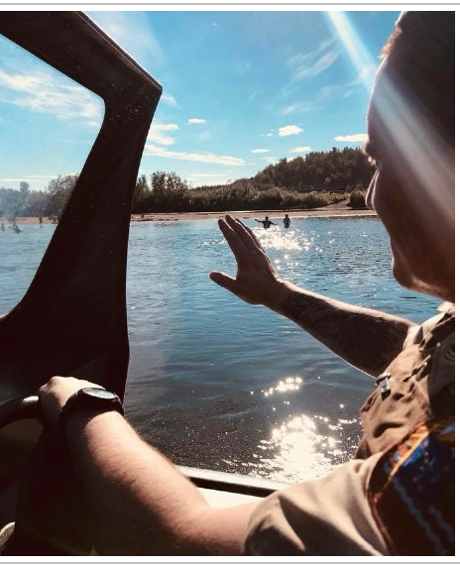
Sample Goals & Strategies
Health and Wellness Goal C: Residents are healthy, safe, and self-sufficient.
Strategy 2. Promote healthy lifestyles and support efforts to address substance abuse, behavioral health needs and suicide prevention.
Strategy 3. Ensure every NAB community has a public safety/law enforcement presence.

Slide 27
Strategies: Sample Criteria for Prioritizing
Simple
Complex
Which strategies:
Have high regional need/ support?
Are most likely to address areas for improvement and take advantage of strengths/opportunities?
Are most likely to achieve desired goals and objectives?
Will have the broadest impact?
Are time sensitive?
Are partially and/or completely funded?
Have a current or likely partner, who can bring additional resources to the table?
 | High Effort (Difficult) | Low Effort (Easy)
High Impact |  | High Priority
Low Impact | X

Slide 28
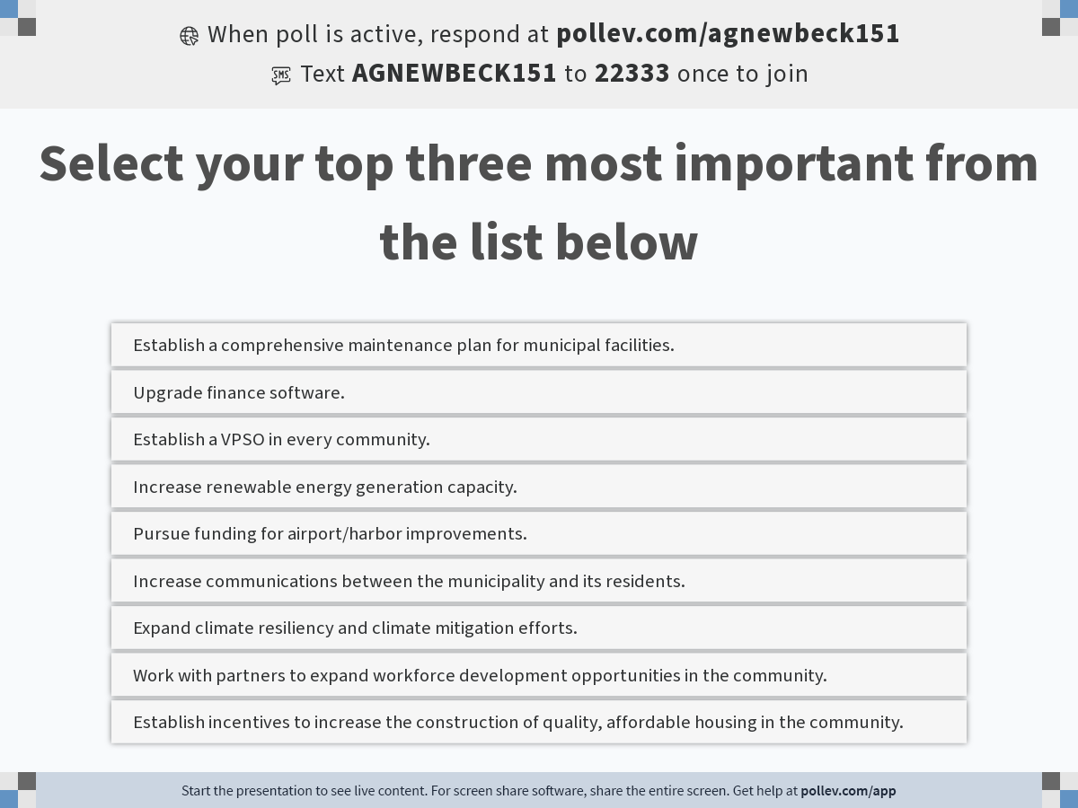
Notes:
Poll Title: Do not modify the notes in this section to avoid tampering with the Poll Everywhere activity.
More info at polleverywhere.com/support
Select your top three most important from the list below
https://www.polleverywhere.com/multiple_choice_polls/ThwbHuneWmu9ZcdAZ3KYD?display_state=instructions&activity_state=opened&state=opened&flow=Engagement&onscreen=persist

Slide 29
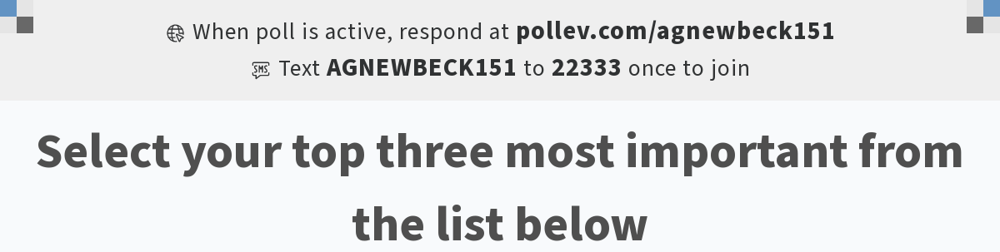
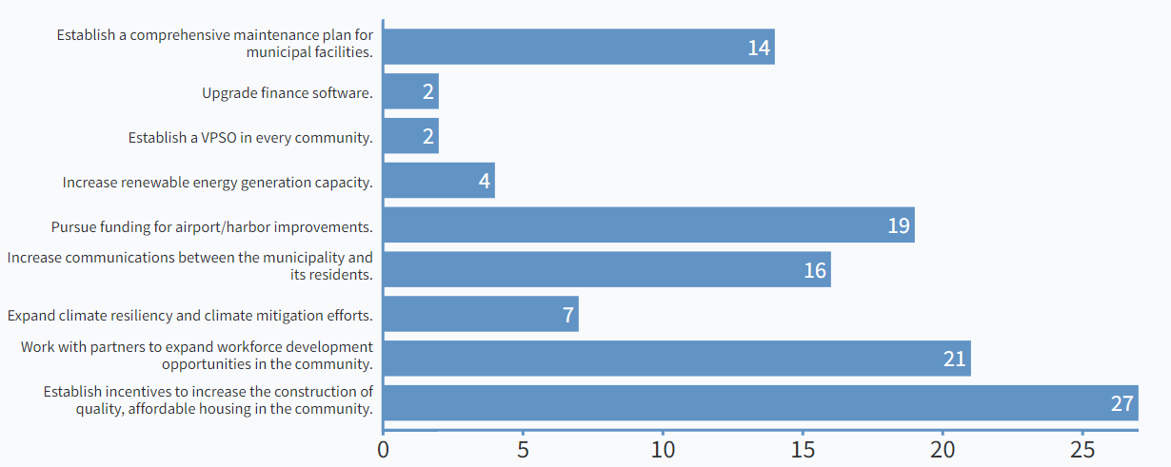
Notes:
Poll Title: Do not modify the notes in this section to avoid tampering with the Poll Everywhere activity.
More info at polleverywhere.com/support
Select your top three most important from the list below
https://www.polleverywhere.com/multiple_choice_polls/ThwbHuneWmu9ZcdAZ3KYD?display_state=chart&activity_state=opened&state=opened&flow=Engagement&onscreen=persist

Slide 30
Action Plan Template
Strategy:
Action | Cost + Resources | Who | When | Progress
What is the concrete task or action need to carry us closer to achieving the strategy? | What resources will help you complete the action item: funding, staff? Is there a specific cost? | Who (person, organization, group) is responsible for this action? Who will lead the effort? | When will it happen? Is there a deadline? Is this action item immediate, mid-range, long term? | What is our progress? How are we doing? Are we able to measure our impact?

Slide 31
Example Action Plan from Fairbanks North Star Borough Comprehensive Economic Development Strategy
Strategy #4: Develop a Resilient Power Grid – Collaborate with other Railbelt utilities to achieve a resilient, efficient power grid that can better integrate future renewable energy sources for power generation.
Capital Project? | Action | Lead | Support | Estimated Resources | Target Completion
✓ | Add an additional 45-50 MW of battery storage to help regulate variable power load from renewables and create backup power during outages/disruptions. | GVEA | AEA, U.S. Department of Energy (DOE) | $70-$75 million | 2025
✓ | Upgrade existing Railbelt intertie from 138 kV to 230 kV. | Railbelt utilities | AEA, Denali Commission, GVEA, FCAC | $170 million | TBD
✓ | Complete planning for and construct the Roadbelt intertie, a 230kV line connecting Anchorage to Fairbanks along the Richardson and Glenn Highways (see the Denali Commission Roadbelt Intertie Project Report here for more information). | Roadbelt Electric Reliability Organization (ERO) | AEA, utility providers, municipalities, Denali Commission, Tribes, FEDC | $1 billion ($566 M for Sutton to Delta Junction) | 2025
✓ | Identify opportunities to collaborate with other sectors (e.g., shared utility easements with telecommunications). | GVEA | IGU, broadband providers, permitting departments of state and federal agencies, Denali Commission, Golden Heart Utilities, FCAC | Varies | Ongoing

Slide 32
Saint Paul Dashboard Example
Indicator |  | 2020 Current | 2023 Target
People
▼ | Annual employee turnover rate | 30.5% | 10.0%
▲ | Resident satisfaction based on % satisfied/very satisfied via community survey | 84% | 85%
▲ | Number of projects community/Island entities are collaborating on annually | 3 | 6
Infrastructure
▲ | Amount of funding received for CIP project implementation | $1,046,425 | $3,500,000
▲ | Number of community facilities with a maintenance plan in place | 0 | 3
ü | Number of CIP projects successfully funded and implemented | 2 | 6
Revenue
▲ | Annual municipal revenue | $8,640,730 | $9,072,766
▼ | Annual utility maintenance costs, adjusted for inflation | $ | $

Slide 33
Top 10 Tips for a Successful Meeting
2
AGENDA: Outline an agenda that defines the process, with time slots and breaks. Aim for a mix of meeting techniques including interactive activities.
4
IDENTIFY PRE-MEETING WORK: What work has already been done? What background information can be shared in advance to focus the meeting?
5
INVITATIONS: Who needs to attend? Who are the decision makers? Are all perspectives represented? When should you send invitations?
FACILITATOR GUIDE: Develop facilitator’s agenda/script with introduction language, needed supplies, transitions, etc.
1
PURPOSE: Identify clear objectives and desired outcomes. This typically involves meetings with leaders/key participants to define expectations.
3

Slide 34
Top 10 Tips for a Successful Meeting
6
SPACE: Identify and reserve an appropriate space. Is there enough room for everyone? Do you need a screen or phone? What layout will support collaboration?
7
REFRESHMENTS: Make arrangements for coffee, snacks, meals. If the meeting is occurring during meal time, indicate whether food is included.
8
ROLES: Identify a notetaker ahead of time (other potential roles: timekeeper, chair).
9
CANCEL: If you’re not ready, better to cancel than have an unproductive meeting.
10
DISTRIBUTE: Send out agenda, background information and connectivity details ahead of time.

Slide 35
Needs Assessments and Feasibility Studies

Slide 36
Needs Assessment & Feasibility Studies
Be clear about the size of the project or program
Test the financial sustainability
Identify specific funding plan
Show funders you’ve done your homework
Housing Needs Assessment
New Program Feasibility
New Facility Business Plan

Slide 37
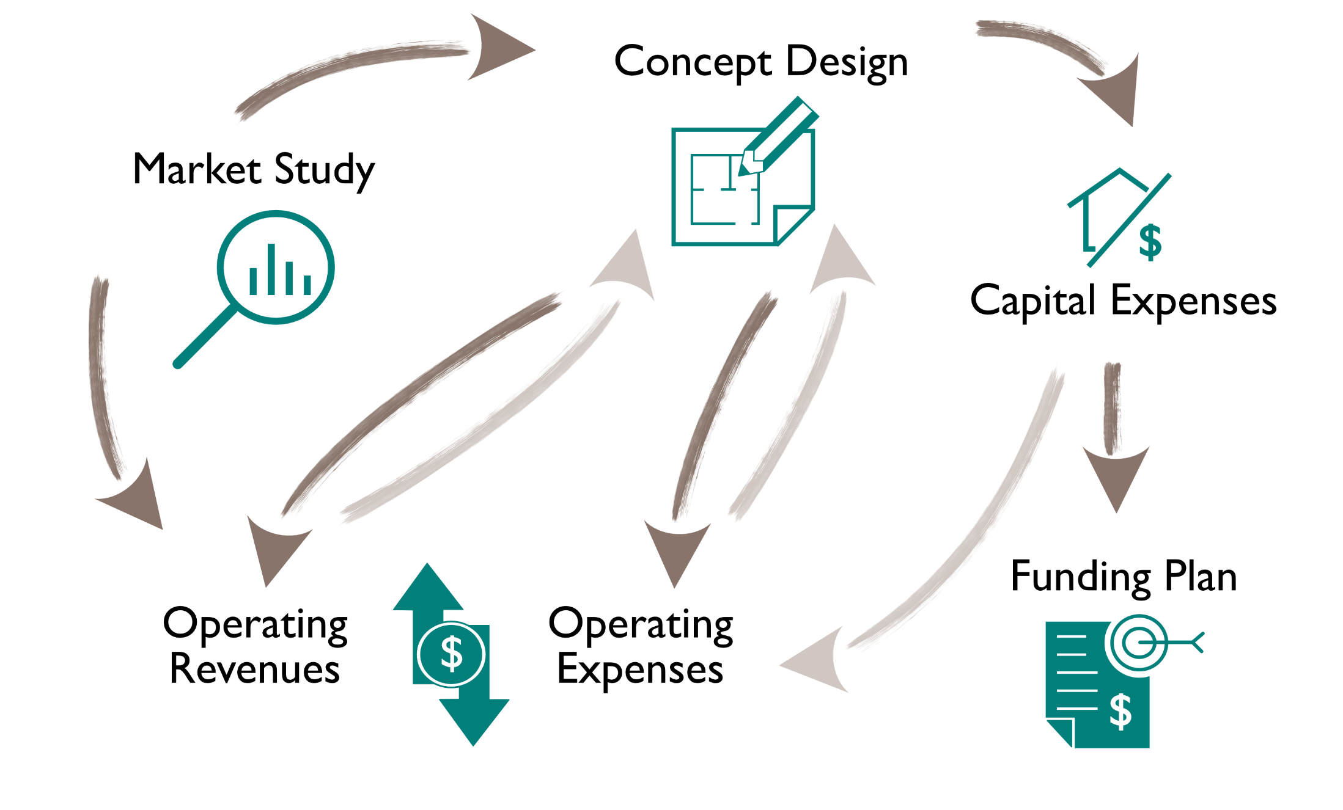
Feasibility Planning – An Iterative Path

Slide 38
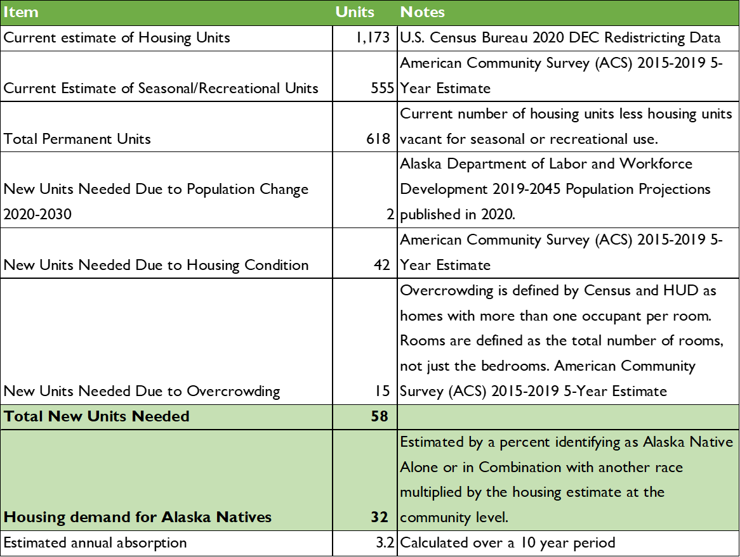
Housing Needs Assessment: Example Forecast

Slide 39
Demonstrate the Need: Grant Writing Keys to Success
 | Documentation | Questions to Answer
Needs Assessment | Pertinent data rooted in trustworthy and current (1-5 years) sources (i.e., U.S. Census) Interviews, surveys or focus groups conducted by your project team All data organized into an understandable defense of the need for your project, including appropriate citations | Does the project address a specific problem or need? What are the measurable indicators that demonstrate this need? Where can you find data about these indicators? Can you find more than one source of data? Based on the data, what are the priorities and goals of your project?
Agnew::Beck
39
Notes:
Joanna here to end of Day 1.

Slide 40
Grant Writing

Slide 41
What is Grant Writing?
It begins with the identification of a concrete solution to a specific problem or action item…
A grant proposal is a request for funding to implement that solution in the form of a project or program, typically for the public good.
Basically, you need to convince funders that:
There is a problem or action to complete.
Your project will help solve that problem/achieve your goals.

Slide 42

How do we come up with projects or programs*?
Start with your goals, not a specific funding opportunity.
Often, community planning documents already outline these sorts of objectives.
*A project usually accomplishes a discrete objective, such as building a community swimming pool, while a program typically provides ongoing services, such as free substance abuse counseling.

Slide 43
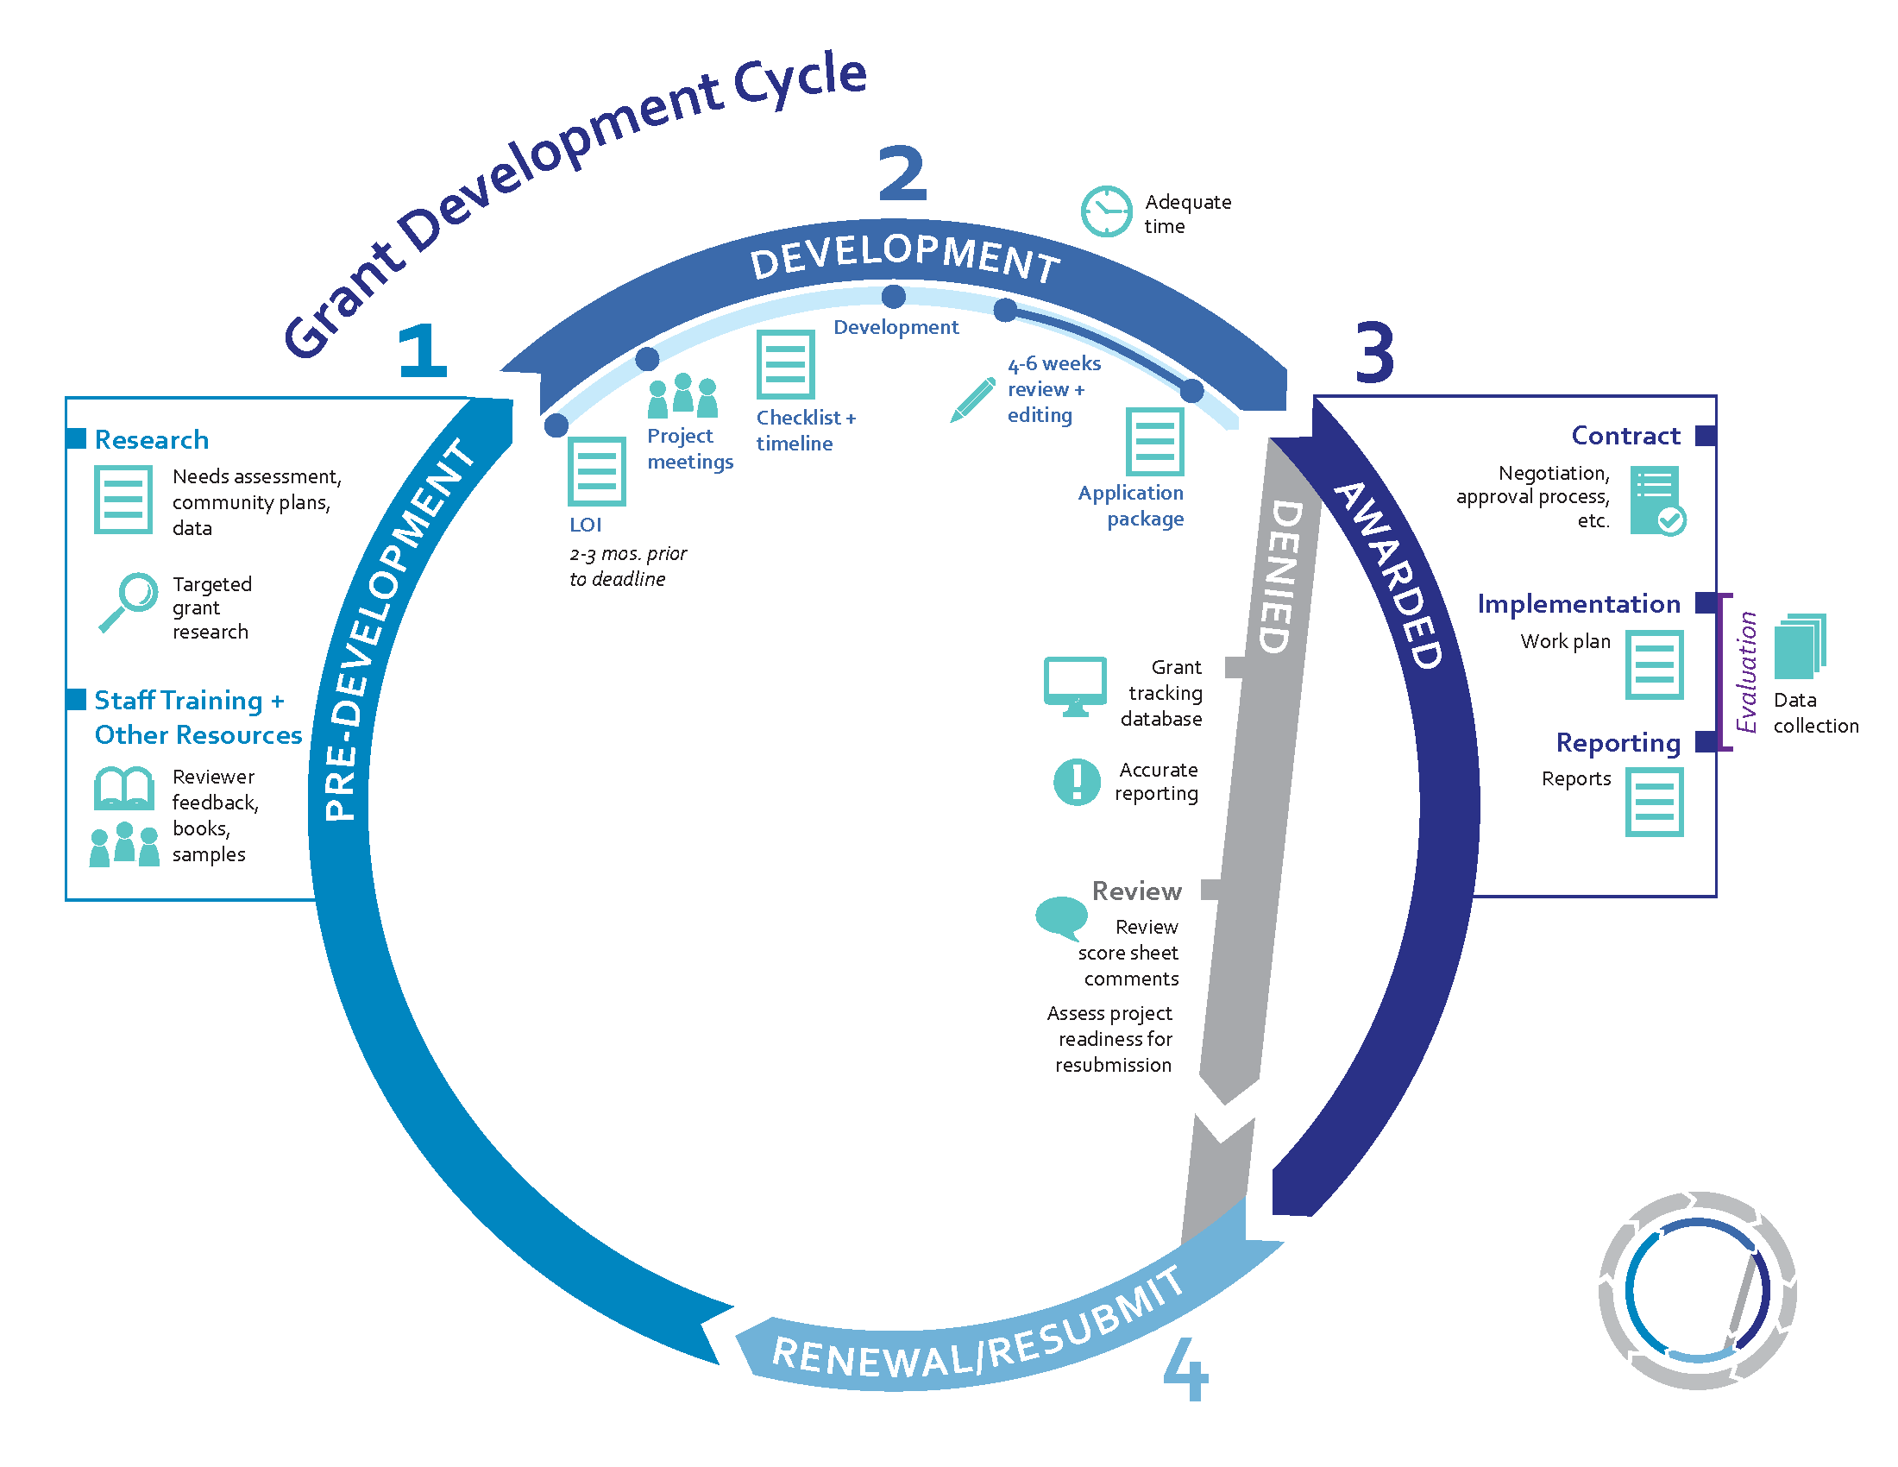
Agnew::Beck
43
Notes:
End of Joanna section. Curtis next slide.

Slide 44
Are you well-positioned for a funding opportunity?
Planning Documents
Community Plans, such as a Comprehensive Plan
Community Economic Development Strategy (CEDS)
Staff Experience & Capacity
Project Manager
Finance / Grants Manager
Relevant Partnerships
Community organizations
Neighboring communities
Strategic Plans
Key Program Staff
Available Time
Government entities
Match Required?
$ or In-kind
Eligible source
Achievable?
Letters of Support
Memorandum of Understanding
Letters of $ Commitment
Prospective or in-hand
How much?
Special Grant Requirements
Specific type of organization
Specific type of program activities
Period of performance
Feasibility is a go
Notes:
Joanna section begins.

Slide 45
What are the types of funders?
Private
Foundations
Direct Corporate Giving
Public
State Grants
Municipal Grants
Family
Community
Healthcare
Corporate
Federal Grants
Includes many American Indians Alaska Natives (AIAN) specific programs
Agnew::Beck
45
Notes:
Curtis section begin.

Slide 46
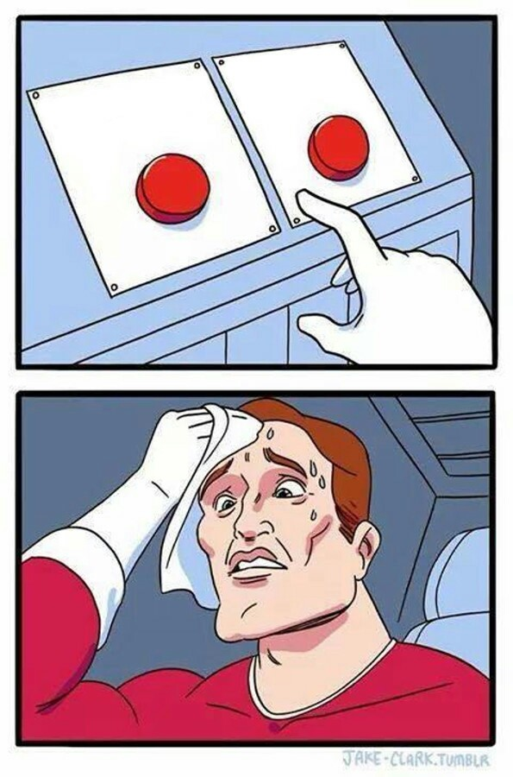
State of Alaska vs. Federal grants…
Federal grants usually…
Have higher award ceilings.
Are more competitive (this may be less true for Tribal-specific grants).
Take more time/paperwork to apply to.
Have more onerous reporting requirements.
State grants usually…
Have lower award ceilings.
Are somewhat less competitive (this is less true as of late; most State programs are currently oversubscribed)
Often are less complex to apply to
May have simpler reporting requirements
Often the state will own the project and implement it.
For large projects (over ~$10 million), the best option is often to pursue both State and Federal funding with local match. State funds are allowed to match against Federal funds (more on that later). Typically, the more money that has been secured for a project, the easier it is to secure the remaining funds.
Federal
State

Slide 47
How do we find grants?
Grants.gov
Look up specific State of Alaska departments relevant to your project and see if they have a grants page
Call people in those departments and ask if they know of any funding opportunities
akfederalfunding.org
Alaska Mental Health Trust Authority e-newsletter
Foraker Group funding guide
Alaska Community Foundation website
Foundation Center
Rural Assistance Center
Alaska Housing Finance Corporation
Other subscriptions (First Nations Development Institute, Rasmuson Foundation, Rural Health Hub)
Agnew::Beck
47

Slide 48
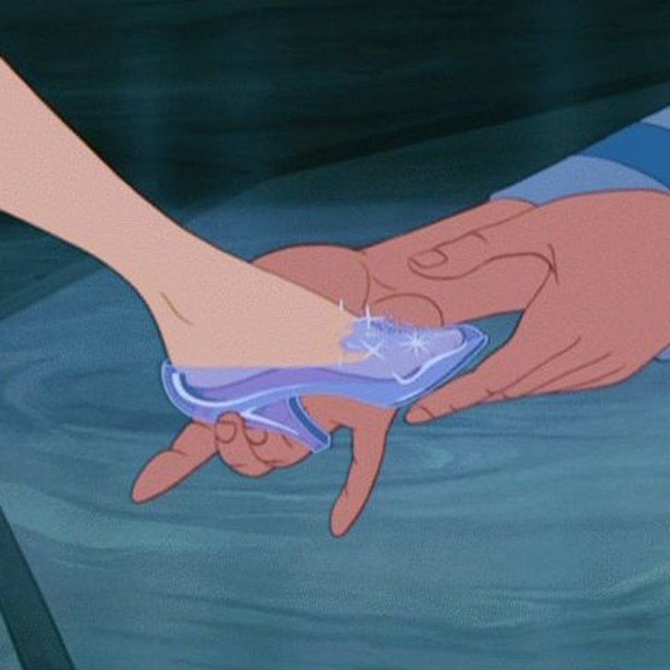
Remember: it’s all about the fit…
Figuring out which grant to apply for is key to being successful. Be picky!
Read “eligibility” sections of Notice of Funding Opportunities (NOFOs) to make sure your organization qualifies.
Pay attention to award ceilings, award floors, and expected number of awards, as well as match requirements.
Call funders and ask if your project is a good fit/if you’re eligible. If not, ask if they have suggestions for other programs.
Agnew::Beck
48

Slide 49
Develop a Strong Budget: What is sustainability?
Identify the resources you will need to continue to meet your projects goals, such as funding, leadership and staffing, and assess the realistic the scale of your activities once your grant ends.
You must be thinking of sustainability before you start writing your grant.
This is part of the reason why it’s often easier to find grants for capital improvements than to fill staff positions: capital improvements are viewed as “one time” in a way that staffing is not.
Agnew::Beck
49

Slide 50

Demonstrating Project Sustainability in the Budget
Future funding plan:
Fee for service or product
Additional grants
Fundraising
Community partnerships
Taxes or other public funding
Future staffing plan:
Leadership buy-in
Workforce development
Professional development for existing staff
Agnew::Beck
50
Notes:
Joanna next slide

Slide 51
Let’s talk about IIJA
The Infrastructure Investment and Jobs Act (IIJA), also known as the Bipartisan Infrastructure Bill, includes $550 billion for American Infrastructure over the next ~5 years.
A little less than half of that is to be competitively awarded through grants.
IIJA is projected to bring about $18 billion to Alaska, or nearly $25,000 per Alaskan.
Its focus areas include:
water/wastewater, broadband, airports and ports, resiliency, clean energy, roads and bridges,
wildfire management.
Agnew::Beck
51

Slide 52
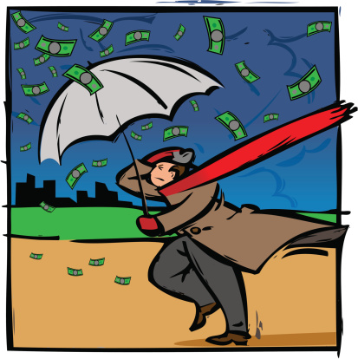
What does that mean for you?
It means a lot! But also… not so much.
There is a historic amount of funding out there. If your community has a big project in one of those focus areas that it wants to fund, now is the time to move aggressively to accomplish it.
At the same time, competition is intense. No matter what you may hear, money is not falling from the sky.
So, how do you take advantage of this historic opportunity..?
Agnew::Beck
52

Slide 53
Demonstrating Support: Project Stakeholders
Key
affect project outcome
Secondary
indirectly affected
Primary
directly affected
Agnew::Beck
53
Notes:
Example: Cordova Harbor Rebuild grant.

Slide 54
Demonstrate Buy-In: Leadership Support
Demonstrating buy-in from leadership is essential
Tribal resolutions
Record or letter of approval from Tribal Council, City Council, Assembly.
Board approval and/or letter of support for non-profits
Identify requirements at the beginning of your process
Allow time for the approval process (council meetings are often only once a month, and you may need to go before them twice)
Initiate drafts with key advisors at the beginning of the grant process
Communicate key dates for documentation
Small detail, big impact: It is tempting to wait until the last minute to complete documents that will end up in the appendix, but they are essential to submitting complete proposal that meets the requirements. Start early!

Slide 55
Develop a Strong Budget: What is sustainability?
“Sustainability” refers to the continuation of a project’s goals, principles, and efforts to achieve desired outcomes. Though it is dependent on funding, sustainability of a project means more than finding the resources to continue it “as is” beyond the grant period. Sustainability means ensuring the goals of the project continue to be met through activities that are consistent with the current conditions.
Funders are looking for sustainability! They are not going to grant money to build a new community swimming pool, for instance, if there’s no plan to staff, maintain, or pay to heat it.
Agnew::Beck
55

Slide 56
Demonstrate: Organizational Capacity
 | Documentation | Questions to Answer
Organizational Capacity + Project Management | Resumes of leadership Resumes of proposed staff List of similarly completed grants or projects Audits or financial review statements Other financial information | What are the credentials of those leading the community? The organization? The project? What other similar grants/projects has your team undertaken? Is your community or organization financially solvent?
Agnew::Beck
56
Notes:
Curtis next slide

Slide 57
Packaging Tips
Read RFP from beginning to end to ensure:
  Eligibility
  Formatting
  No attachment omissions
Do the logic model and budget first
Proof-read!
Proof the budget!
It always takes longer than you think
Agnew::Beck
57

Slide 58
Setting Up for Success: Grant Project Planning
Use a tracking tool that works for you.
Set up a proposal development plan.
Invite relevant staff and partners to a grant kick-off meeting.
  Begin working on the budget as soon as possible. This helps people to visualize where the project is headed and what they will be expected to contribute
Create a proposal development schedule and keep everyone in the loop on what is needed and the status of deliverables.
Schedule regular check-in meetings with contributing staff and/or partners.
Do not wait until the end to start the forms. Do them early on and cross them off your list.
Schedule submission date at least 2 days before deadline, preferably a week before.

Slide 59
Setting Up for Success: Grant Project Planning
Tracking Tools: Application Components

Slide 60
Award Management – Best Practices
Identify who is responsible for funding requirements when you are awarded
Create a Grant Tracking List / Calendar
Organize funder information (contacts, deadlines)
Coordinate team responsibilities: accounting, reporting, program implementation and tracking
Assemble library of boilerplate information and supporting documents.
Internally report on progress on a regular basis
Submit requirements early
Contact funders with questions or project performance issues if necessary

Slide 61
Grant Reporting
Using pre-defined performance measures, tell the funder what has been accomplished, what has not, and any changes or unforeseen circumstances.
Every funder wants something different—make you know what that something is.
Stay on schedule. Have a designated staff member whose responsibilities include the reporting (often a member of the finance team).
Agnew::Beck
61
Notes:
Page 101

Slide 62
Not awarded?
Many times it takes 2 or 3 successive applications to the same grant program to be awarded (particularly for large federal grants).
Request a debrief for any grant you are not awarded.
A debrief is where a funder walks you through where your application lost points.
  This is critical for strengthening large applications, and lets you know where to target your improvements.
  It will also help you grow as a grant writer.

Slide 63
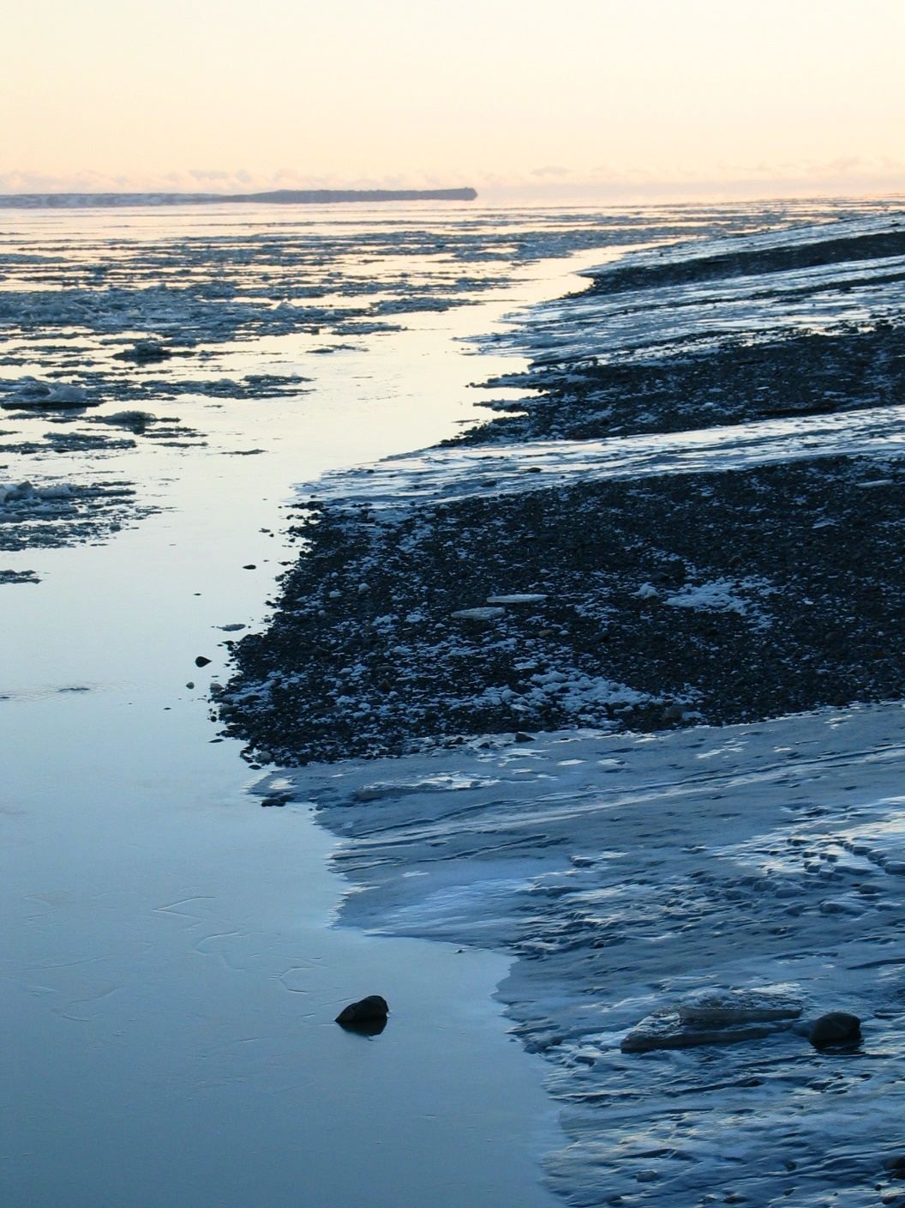
Thank you!
Shanna Zuspan, AICP
Principal::Owner
Agnew::Beck Consulting
907.277.5535 Office
907.280.9518 Cell shanna@agnewbeck.com
Tanya Iden, AICP
Principal::Owner
Agnew::Beck Consulting
907.277.5424 Office
tanya@agnewbeck.com
www.agnewbeck.com
Engage. Plan. Implement.
Kanakanak Beach, Dillingham (ca. 2003)

