Slide 1
Resources for Tribal and Municipal Governments
Bristol Bay Sustainability Summit
March 23, 2023
Erin Reinders
Director of Infrastructure Development
erin@akml.org
Notes:
Thank you so much for having me today! Good Morning, Friends!
I am Erin Reinders, the Infrastructure Program Director with the Alaska Municipal League.
AML is a nonprofit, nonpartisan, statewide organization with a purpose of strengthening Alaska’s local governments. We are committed to supporting Alaska’s 165 cities and boroughs, in maximizing the benefit to Alaska, and fostering statewide collaboration, especially with all the opportunities coming from the Bipartisan Infrastructure Law.
Today I will share a bit about what AML has been doing in response to IIJA, various resources that are available,, and share some closing thoughts to ponder as we seek to participate in these once in a generation opportunities.
AML Response
Resources
Closing Thoughts
So lets get started!

Slide 2
BIL/IIJA Overview
Signed into law by President Biden one year ago, on November 15, 2021
Authorized $1.2 trillion for transportation and infrastructure spending; $550 billion of that figure going toward “new” investments and programs.
Urgency can be spread across at least the next five years; implementation over the next ten
Goal for Alaska is $3 billion/year; including $1 billion in successfully competed grants
Notes:
The Infrastructure Investment and Jobs Act (IIJA), aka Bipartisan Infrastructure Law (BIL), was signed into law by President Biden on November 15, 2021. The law authorized $1.2 trillion for transportation and infrastructure spending with $550 billion of that figure going toward “new” investments and programs.
Combination of formal funds and competitive awarded grants. IIJA is projected to bring about $18 billion to Alaska, or nearly $25,000 per Alaskan.
This is considered to be a once in a generation investment.

Slide 3
BIL/IIJA Buckets
Energy & Power –
Upgrade Electricity and Transmission Infrastructure
Water & Sewer – Ensure Clean Drinking Water and Sanitation
Internet & Cybersecurity – Provide High Speed Internet for All
Transportation - Improve Transportation Systems
Promote Resiliency
Notes:
IIJA funding falls into five broad categories – or “buckets” –
internet and cybersecurity;
energy and power,
transportation systems including docks, airports, bridges and more;
water and sewer, and resilience.
Resiliency incudes wildfire management,
All of which can have a huge impact on Alaskan communities.

Slide 4
Infrastructure Program
Goals
Maximize Benefit
Strengthen Capacity
Inputs
Collaboration
Competency
Outputs
Shared resources
Grant Assistance
Outcomes
Impacts
Competitiveness
Strategic Planning
Events
Outreach
Informed membership
Competitive applications
Project development
Partnerships
Grant funding and management
Address infrastructure deficit
Notes:
AML has increased its efforts to support local governments during this historic time. We are supporting Alaskan communities with identifying funding opportunities, providing informational resources, and fostering partnerships.
We developed this logic model to outline AML’s response to the IIJA or BIL.
Overarching Goal:
Maximize the benefit to Alaska and foster statewide collaboration, especially with all the opportunities coming from the Bipartisan Infrastructure Law.
Help position local governments for success by being a resource for partnerships, information, and guidance. We recognize that capacity is a hurdle for many, and want to augment that.
We stive to do this through:
our own research and learning,
hosting learning and networking events, for example we have hosted Infrastructure Symposium in April and September 2022.
collaborating with partners, more on that soon
identifying opportunities shared services, we will talk about this in a bit too.
informing and engaging with our membership, we have regular emails going out to members and we host weekly Infrastructure Office Hours, more on that in a few slides
By being flexible and responsive to member needs and this changing environment.

Slide 5
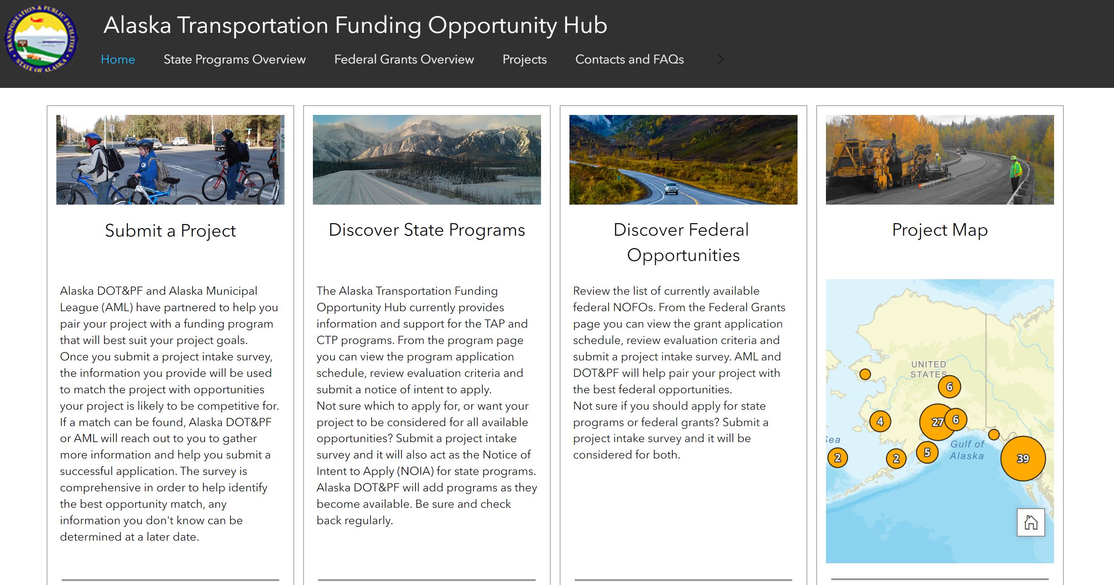
AML and DOT&PF Partnership
Notes:
In June of 2022 AML and DOT&PF have signed a Memorandum of Agreement (MOA) to partner and share resources to support local and tribal governments in order to capture competitive, discretionary grants for local transportation projects.
This partnership has resulted in the development of the Alaska Transportation Funding Opportunity Hub. On this page, you will find resources such as:
Project Intake Form
State Opportunities
Federal Opportunities
Project Map
Project Intake Form:
This is open to local government, tribes, schools and more
Filling out this form helps communicate project needs, might help the State or AML identify funding opportunities, and might result in assistance form DOT&PF with the project or the application.
You will have to know basic project information to complete the form. There is a pdf of the format is available through the link so you can take a look at the questions before hand.
State Programs: Discover State Programs has details on the various programs including a schedule of deadlines and the evaluation criteria.
Federal Programs: The Federal Opportunities page is a similar set up and has information on transportation-focused federal grants. There is information on timelines, what types of projects are eligible, match requirements, and links to the NOFOs. As new federal programs are added or as we move through grant cycles, this information will be updated and added to.
Project Map: Finally, there is the Project Map. When you submit a Project Intake Survey you will be asked to drop a pin on a map that shows where your project will be. We will use that information in evaluating the eligibility and competitiveness of your project, but it will also be added to the Project Map. The Project Map will not have all of the information from your project survey, it will have only the basic information. The reason for this map is to give a visual representation of the need for transportation infrastructure across the state. It will also help group projects that may be more competitive as a bundled project and allow potential partners to seek each other out.

Slide 6
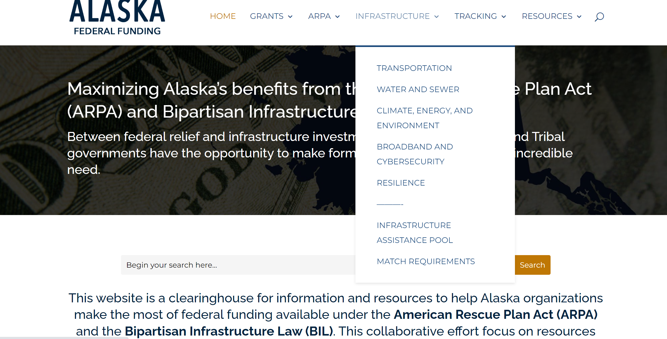
AKFederalFunding.org
Notes:
AKFederal Funding site had its beginning with ARPA and continues to be available. This website is also a clearinghouse for information and resources to help Alaska organizations make the most of federal funding available under the (BIL). I imagine this will be expanded to the IRA as well.
It is a shared effort of the Alaska Infrastructure Coordinating Committee (AICC) –,. an informal network of Alaska organizations that work to share information, foster collaboration, and see Alaska maximize its potential response to these opportunities. Group includes reps from AFN, University of Alaska, ANTHC, Denali Commission, state of Alaska
News and grant information
Resource Links
Resources for ARPA and IIJA/BIL by topic, likely will expand to Inflation Reduction Act (IRA)
Trainings/events
Match Requirement Form
Links to Transportation Hub

Slide 7
Weekly Office Hours
AML Update & Announcements
Follow ups
Questions & Discussion
Tuesdays,
9-10am
Notes:
AML hosts weekly office hours.
This regular time together will help provide a time for
Questions
Information sharing regarding infrastructure grants and implementation.
To help identify opportunities for partnerships, collaboration or coordinated approaches
For AML to learn more about what you are looking for and how we can help
This is a time colleagues throughout the state and learn together. We also welcome guest speakers from time to time to discuss various infrastructure topics or funding opportunities.
Just this week we had HDR come and review the PIDP program, next week we have a repletion from UDSOT to discuss transportation opportunities and support for rural communities.

Slide 8
Grant Writing Assistance
Grant Writing Hotline - a free service that we are offering so that you can call and speak with a professional grant writer and get advice for next steps.
Desk Review - a free service to members that we are offering through HDR, where HDR will review your draft application and provide you feedback for how to improve it prior to submission
Select Templates (NEW) – AML staff will review NOFO and provide application template (just did this with RAISE)
Contract Services (NEW) - AML is offering shared services that allows you to contract with us for application Support, Drafting, and Submission. Agreements can be tailored to your needs!
Notes:
We off some grant writing assistance options that are free for all members.
Grant writing hotline continues, and we have our pool of grant writers that you could contract with.
If you have a grant application completed, you could also take advantage of our free Desk Review to review feedback prior to submission.
We are starting to do some applications templates up for popular grant programs, like RAISE.
We are now offering grant application assistance as a member benefit option on a contract basis…
to support the application, creating a template, drafting the application itself and aiding in submitting the application.
We expect application expenses to range from $5-10,000, unless a BCA is required which does add costs.
Reach out to us if this is something you are interested in exploring! Agreements will be tailored to your needs!

Slide 9
Other Resources
Grants.gov
National League of Cities (NLC)
Infrastructure HUB: https://localinfrastructure.org/funding-opportunities/ (Great search tool!)
USDOT
DOT BIL Key Notices of Funding Opportunities: https://www.transportation.gov/bipartisan-infrastructure-law/key-notices-funding-opportunity
Rural Opportunity to Use Transportation for Economic Success (ROUTES): https://www.transportation.gov/rural
White House
BIL Rural Playbook - https://www.whitehouse.gov/build/rural/
IRA Guidebook - https://www.whitehouse.gov/cleanenergy/inflation-reduction-act-guidebook/
Upcoming Funding Opportunities - https://www.whitehouse.gov/wp-content/uploads/2023/02/Open-and-Upcoming-Infrastructure-Funding-Opportunities-Feb-6-2023-VF.pdf

Slide 10
Reoccurring Themes
Many allow for group applications – interest in bundled projects
Find information in NOFOs, webinars – lots of technical assistance
Many programs have >80% Federal Share, Rural set-asides for AK
Emphasis on disadvantaged and rural - competitive advantage
Criteria focus on safety, state of good repair, economic impact
New criteria to many programs include equity, sustainability, climate impact, new technologies, etc.
Notes:
There are a few general points that could be made about many programs in the BIL, some of which could be a real competitive advantage for Alaska.
Many programs
Encourage partnerships
allow for bunded projects
Have rural set aside for funding and no match for tribes
Emphasis on rural communities
Program criteria typical seem to focus on safety, state of repair and economic impact but
Also incorporate equity issues, sustainably, climate impact and integrating new technologies.
Consider partnerships with others. That’s often a way to reduce match requirements and increases competitiveness.
Look for possible project bundling opportunities. Might help with mob/demob costs and increase competitiveness. Consider partnerships, again.

Slide 11
Ponderings
If your project isn’t ready, you could focus on the next round and getting your project ready…
Spend the time to clearly define the scope, phases, and rational of your project.
Ensure environmental work, NEPA, and economics are worked out.
Many grants are requiring benefit cost analysis BCA’s.
Nurture partnership opportunities
Look at your plans (partner’s plans, State’s plans, Region’s CEDS…). The more connections we can make to them the better.
Many programs call for community benefits & public participation plans
Be open and flexible.
Some grants are for planning first, but then qualify you for construction grants in the future.
Consider applying for one phase of a project to gain momentum (portion of the project, the planning phase or preliminary engineering)
Notes:
We have found that competitive applications have clearly defined scopes, phases and rational. They can outline a schedule. Have their environmental and design work clear and the economics of the project worked out. If your project is not ready, these are the things you might want to focus on.
Reference plans as much as possible, the more connects you can make the better. Comp plans, special studies, state transportation plans, regions CEDS are some ideas.
You might need to apply for a planning or design grant one cycle to then make you more competitive for the construction grant the next cycle.
Many grant applications are asking about community benefits that including workforce development and jobs, as well as public participation plans stressing meaningful engagement.
Consider planning and project phasing.

Slide 12
Thank you!
Alaska Municipal League
Erin Reinders
Infrastructure Program Director
erin@akml.org
Notes:
Thank you all for having me today. I hope that was helpful. I leave you now with some points of contact that might be helpful for you. Please do keep in touch and I hope to see you on the Office Hour call this time,
Again, thank you. And thank you for all each of you do every day in service with your communities, it is important work.

