Slide 1
Department of Environmental Health & Engineering
Presented by Victoria Jelderks, Engineering Project Manager IV
Slides by Joyell Acuna, Engineering Project Manager I

Slide 2
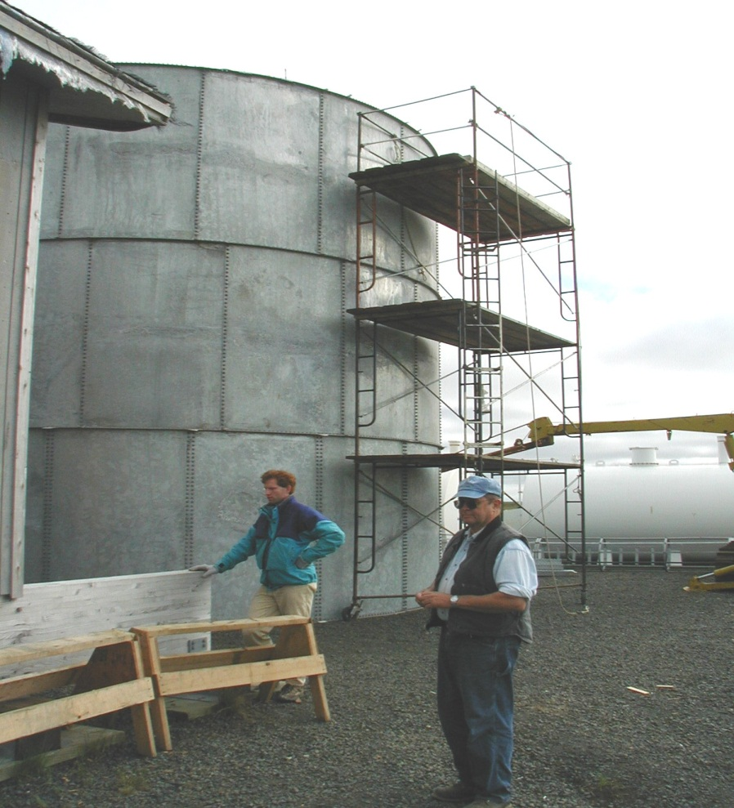
DEHE Mission
“Providing sustainable environmental health
solutions, in a cooperative partnership with the people we serve, to create healthy and safe Alaska Native communities.”
By Developing, Designing,
Building, Training, Operating,
and Managing water and sewer
infrastructure for rural Alaskan
villages.

Slide 3
Agenda
ANTHC DEHE Organization
Sanitation Facilities Construction
Utility Management Support
Community Environmental Health
Health Facilities
Project Workflow
Planning
Design
Construction
Funding Sources
SDS
CIP
ICDBG and CDBG
SRF Loans

Slide 4
ANTHC Department of Environmental Health and Engineering
Program Support
Sanitation Facilities Construction
Utility Management Support
Community Environmental Health
Health Facilities
Project Management
Contract Delivery Team
Design
Construction
Tribal Utility Support
Alaska Rural Utility Cooperative
Scattered Sites
Energy
Quality
Notes:
Victoria, this is not exactly how our org charts laid these out, but this is how it made sense to group them for the purpose of this presentation. Feel free to update this to match the org chart at DEHE Org Charts November 2021 (anthc.org)

Slide 5
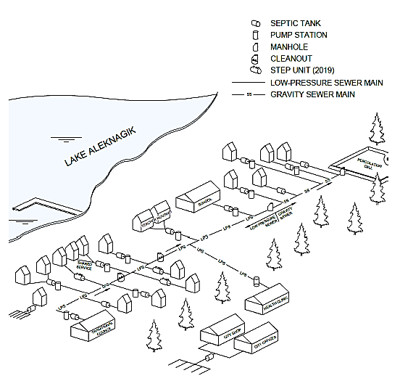
Sanitation Facilities Construction
Water, Wastewater, & Solid Waste Projects
Project Management
Contract Delivery Team
Design
Construction
Aleknagik Wastewater System Project

Slide 6
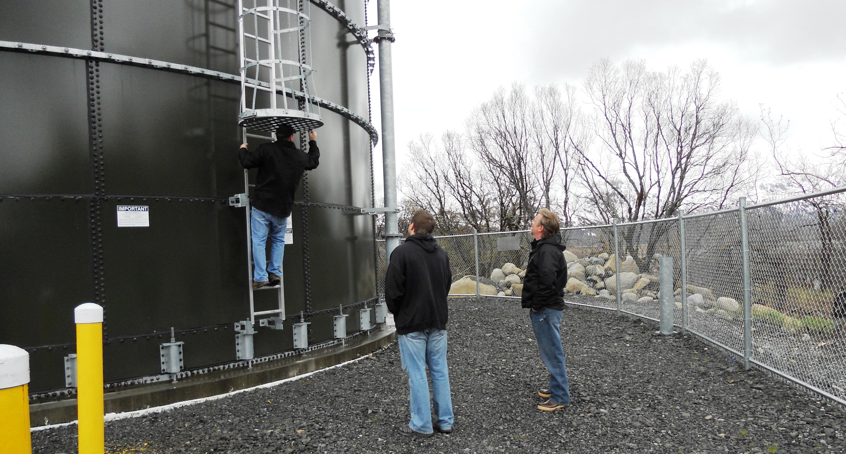
Sanitation Facilities
1980 – 25% Served
1996 – 55% Served
Today – 80+% Served
Infrastructure, Investment, and Jobs Act (IIJA)
$3.5B for IHS Sanitation Facilities; $2.2B for Econ. Infeasible projects
$675.5M/yr for 5 years: FY22 thru FY26
Notes:
We have made a lot of progress since 1980 and have now provided water and wastewater services to 80% of the homes in rural Alaska. There is still much to be done and the last 20% is likely to be the most challenging.
In addition the service improvements we provide each year, we are also committed to providing these services to 1.5% of the unserved homes each year.

Slide 7
ANTHC Project Managers for Bristol Bay
Victoria Jelderks
vajelderks@anthc.org
Cy Two Elk
catwoelk@anthc.org
Joyell Acuña
jracuna@anthc.org
Chignik Lake
King Salmon
New Stuyahok
Perryville
Togiak
Aleknagik
Chignik Bay
Dillingham
Goodnews Bay
Koliganek
Levelock
Naknek
Ugashik
Chignik Lagoon
South Naknek
Twin Hills
*For other Bristol Bay communities see VSW Website contact sheet at https://dec.alaska.gov/Applications/Water/OpCert/community-water-sewer-improvement-contact-list.xlsx

Slide 8
Utility Management Support
Tribal Utility Support
Support non-ARUC communities (VSW & ANTHC)
Operation and Maintenance Training & Support
Alaska Rural Utility Collaborative
Communities elect to be in ARUC
Emergency Response
Small Projects
Assists management & operations of utility
Billing Collection
Notes:
The Alaska Rural Utility Collaborate (ARUC) provides third-party utility billing services to community members in an effort to sustain the facility for the long-term. As part of the ARUC, communities have also benefited from water system operator retention and remote monitoring of their systems for fuel and water usage.

Slide 9
Scattered Sites
Program
Eligible Home
Eligible Person
Individual wells, service lines, septic systems, etc.
Applications accepted year round
Funded by IHS housing
New or like new (non-HUD)
Structurally sound
Occupied year round
Has interior plumbing
Thermostatically controlled heat
Continuous non-generator power
Alaska Native or Native American
Owns land or has long-term lease
Referred patient w/ medical conditions
*See Individual Sanitation Facilities Scattered Sites Program | Alaska Native Tribal Health Consortium (anthc.org) for application

Slide 10
Energy
Energy
Program
Biomass heating
Energy Efficiency
Wind-to-heat
Hydroelectric
Remote Monitoring
Heat Recovery
Solar
Ex. Chevak water / sewer rates decreased from $165 / mo to $85 / mo via heat recovery, energy efficiency, wind integration

Slide 11
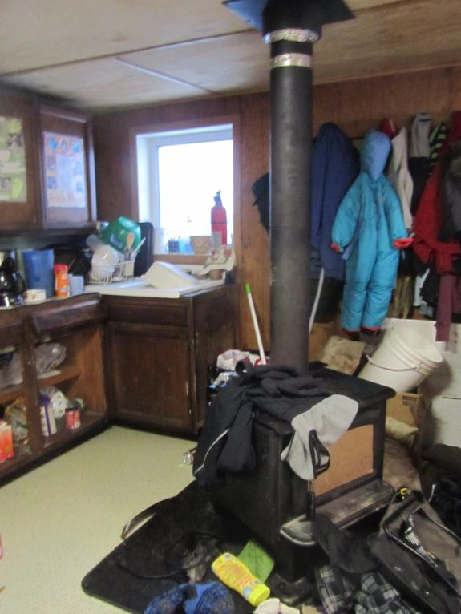
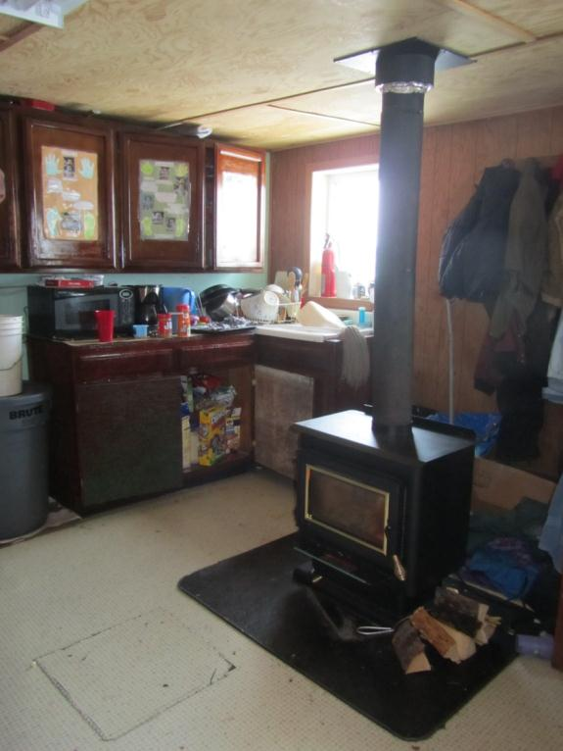
Environmental Health Support
New EPA-certified,
low-emission woodstove
Old woodstove
Notes:
The recent Healthy Homes initiative is just one example of how the Environmental Health Support group is exploring how we can makes homes healthier in rural Alaska. This successful project looked at the air quality in homes with children under the age of two who experienced recurring respiratory infections and other diseases. In many cases old stoves and poor ventilation were the common factors in these children’s illnesses, both of which were easy for DEHE to remedy.

Slide 12
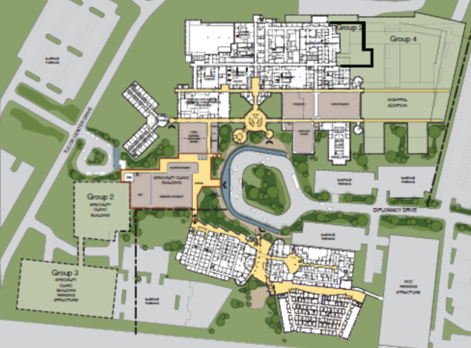
Health Facilities Support
Coordinate ANTHC’s capital facility planning strategy:
Medical Services Plan
Facilities Master Plan
Maternal Child Health
Parking Garage and Patient Housing
Clinical Services Expansion
Notes:
You might think you’ll rarely run into DEHE again in your daily work at ANTHC, but we also coordinate the Campus Facilities program on the ANTHC campus in consultation with our providers and partners. This is an exciting time to join ANTHC and there are several innovative campus projects just on the cusp of improving our campus further.

Slide 13
Sanitation Project Workflow
Planning
Design
Construction
Identify deficiencies
Apply for funds
Preliminary Engineering Report or Technical Memo
~1 year
Apply for funds
Contract or in house
Survey, CAD, Engineering
Review by stakeholders (environmental, RHO, etc.)
~1-2 years
Construction Planning
Contract or in house
Material purchasing, freight
Mobilization
Complete construction
~1-3 years
Note: Warranty period typically 1 year

Slide 14
Funding Sources: Sanitary Deficiency System (SDS)
SDS
Indian Health Services (IHS) Regular
Environmental Protection Agency (EPA) Safe Drinking Water Tribal Set Aside
EPA Clean Water Act Indian Set Aside

Slide 15
Funding Sources: SDS
Year Round
Project Managers (PMs) work w/ community to identify and document deficiency
Spring
PM develops planning document for proposed project
Summer
PM enters project into SDS STARS
Fall
Review by IHS Local and National
Winter: Determination of which projects receive funding
Next Spring: Funds are released

Slide 16
Funding Sources: Capital Improvement Projects (CIP)
United States Department of Agriculture, Rural Development
Capital Improvement Project Funds
State of Alaska, Village Safe Water

Slide 17
Funding Source: CIP Planning
Year Round: PM works with community to identify deficiencies
Winter: PM develops application
Typically March: Applications are due
Typically Mid-Summer: Application are scored and accepted or rejected
Winter: Funds are released
Next Spring: Planning begins
Next Fall: Planning document finalized

Slide 18
Funding Source: CIP Design Construction
Spring:
PM submits application using approved planning project
Typically Mid-Summer: Applications are scored and accepted or rejected
Winter:
Funds are released, construction planning begins
Next Spring: Material purchasing, Mobilization
Next Summer:
Construction begins (Could take 2 seasons)

Slide 19
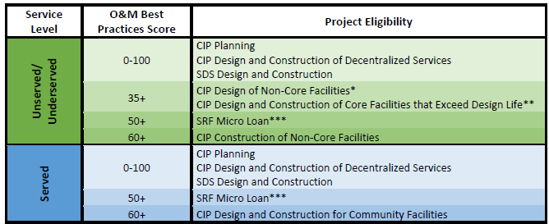
Importance of BP Scores
New CIP Funding Access & Risk of Losing Existing CIP Funding
Core facilities include the water source and transmission, water treatment plant/washeteria and associated storage, collection and treatment of wastewater from the washeteria, and honey bucket disposal.

Slide 20
Technical Score Checklist

Slide 21
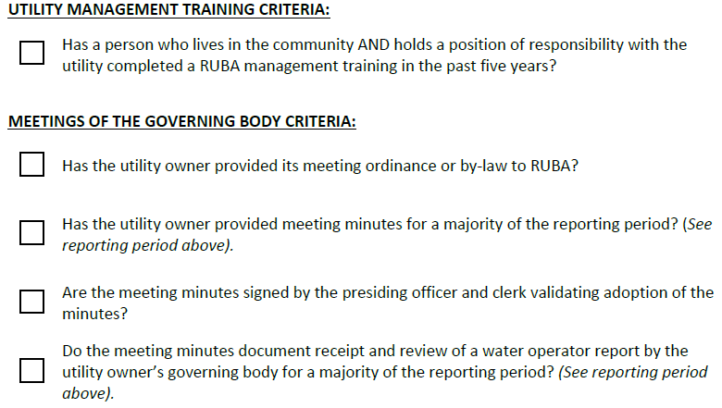
Managerial Score Checklist

Slide 22
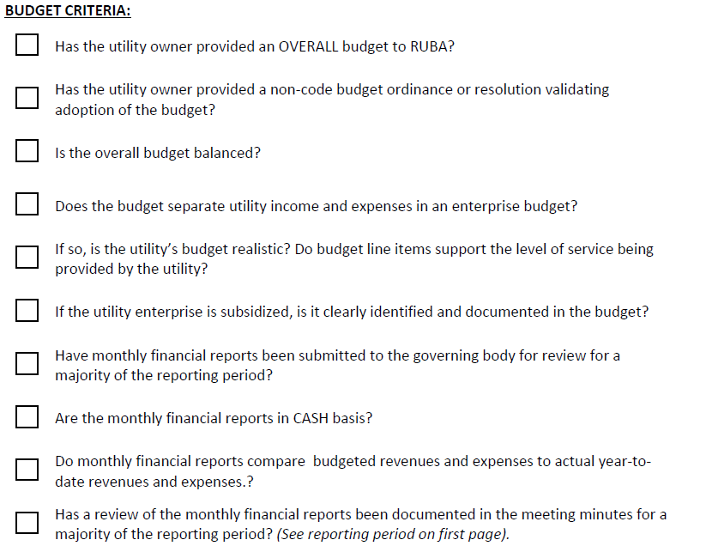
Financial Score Checklist

Slide 23
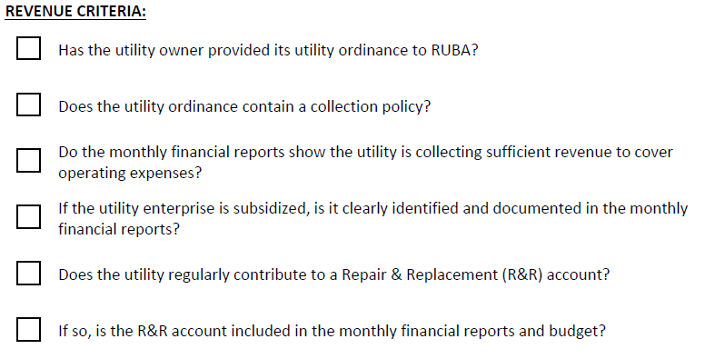
Financial Score Checklist

Slide 24
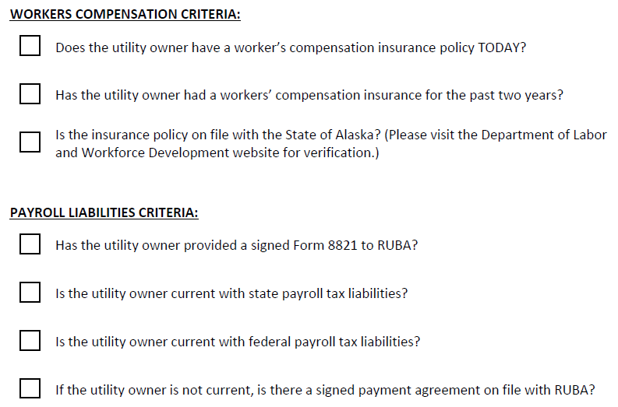
Financial Score Checklist

Slide 25
Best Practice Score Schedule

Slide 26
Funding Sources: Indian Community Development Block Grant
Eligibility
Any Indigenous Tribe, Group, Nation, or Village which has established a relationship to the Federal government as defined in the program regulations
Categories
Housing
Infrastructure
Schedule
Varies – work with community PM
Roads
Water and Sewer
Multipurpose Buildings
Economic Development
Note: Funding cap varies but is usually less than $600k

Slide 27
Funding Sources: Community Development Block Grant
Eligibility
Municipal Governments
Categories
Public Facilities
Access to Public Facilities
Schedule
Varies – work with community PM
Transportation Improvements
Real Property
Fire Protection Facilities and Equipment
Water and Sewer
Solid Waste
Note: Funding cap varies but is usually less than $600k, usually requires a certain amount of matching funds

Slide 28
Funding Sources: State Revolving Fund Loans
Eligibility
Categories
Schedule
Municipally owned Water & Wastewater Utilities
Non-profit & Private Water Systems if regulated by RCA
Some Private Wastewater Systems
Public Facilities
Water and Sewer
Public Health
Emerging Contaminants
Water Quality
You can apply any time
Contact:
dec.srfprogram@alaska.gov
Notes:
Low interest loans.
Young Ha
907-269-7544
young.ha@alaska.gov

Slide 30
Questions?
ANTHC DEHE Organization
Sanitation Facilities Construction
Utility Management Support
Community Environmental Health
Health Facilities
Project Workflow
Planning
Design
Construction
Funding Sources
SDS
CIP
ICDBG and CDBG
SRF Loans

